Slide 1
Expense Reports
Middle Georgia State College
PSFIN v.9.2 upgrade

Slide 2
Expense Report Process
Traveler enters Expense Report online
  Can scan and attach electronic copies of receipts, other documentation
  Traveler electronically signs Expense Report
Traveler submits Expense Report online
  Workflow sends submitted Expense Report to first approver
Approver(s) approve/deny Expense Report online
Final approval comes from AP Auditor
  Makes Expense Report available for payment

Slide 3
Purpose
Seek reimbursement for official travel
Seek reimbursement for supplies or other items purchased to perform job duties (institution-specific)

Slide 4
New Expense Report Features
One link for creating and modifying an Expense Report
All info entered on same page now
Menu bar changes from report-based to expense-based
No odometer readings for mileage
Per Diem on First/Last Day of Travel: Automatic 25% deduction
Quick-Fill
“Commercial Transportation” available as expense type
Can include attachments
Online verification
Report can be withdrawn if it has not been acted upon in the approval process

Slide 5
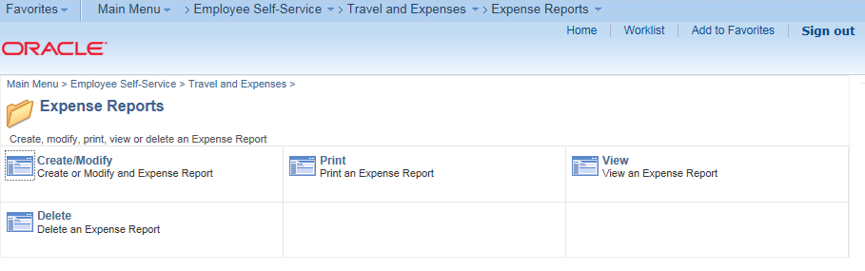
Create Expense Report

Slide 6
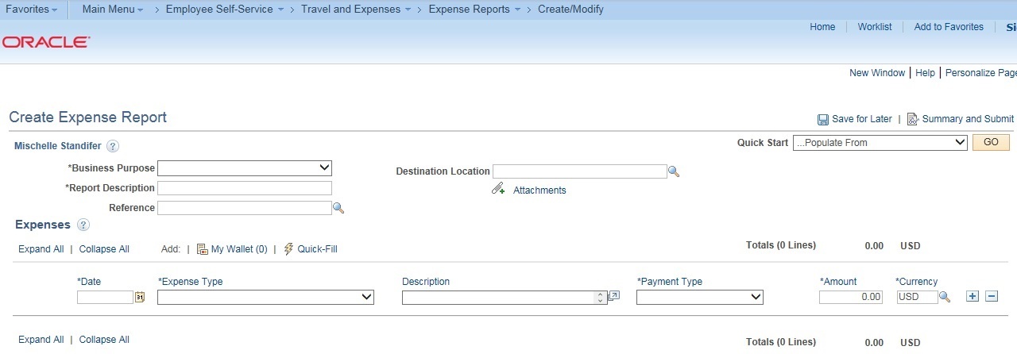
Expense Report Fields

Slide 7
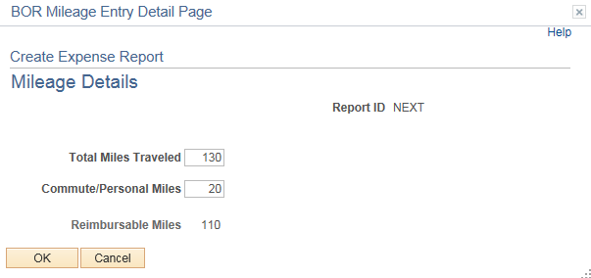
Entering Mileage
No longer need to enter odometer readings
Enter total miles and commute/personal miles

Slide 8

First/Last Day of Travel Per Diem
State Requirement: Deduct 25% from per diem on first/last days of travel
Select a meal as the Expense Type and the “First or Last Day of Travel” link appears

Slide 9
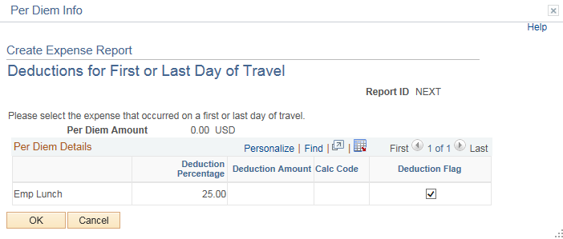
First/Last Day of Travel Per Diem

Slide 10
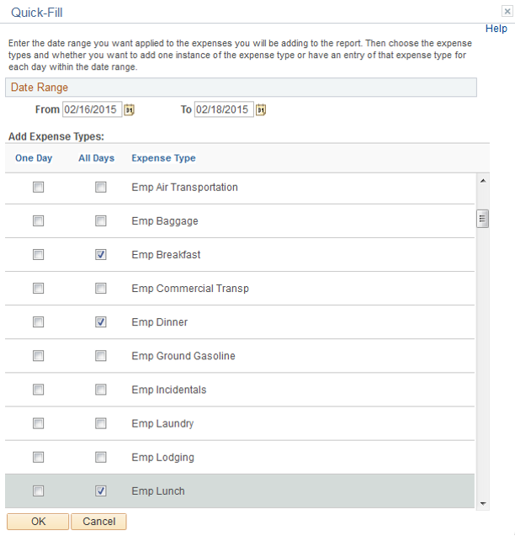

Quick-Fill Functionality
Select Quick Fill link
Enter Range of Dates
Add Expense Types and indicate if they apply to one or all days

Slide 11
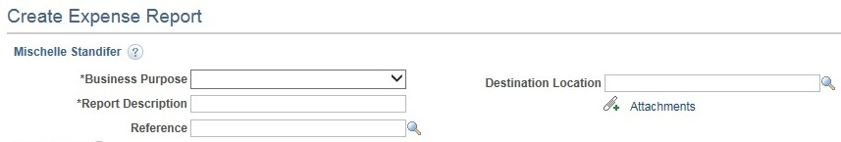
Attachments
Useful for attaching scanned copies of receipts or other documentation
Attachments stay with Expense Report
Use Attachments link, browse for file and upload it
Can add multiple attachments

Slide 12

Submitting Expense Report for Approval
Can save Expense Report for later and modify it before submitting for approval
Must complete online verification to enable “Submit” button
Once submitted, Expense Report enters workflow for approvals

Slide 13
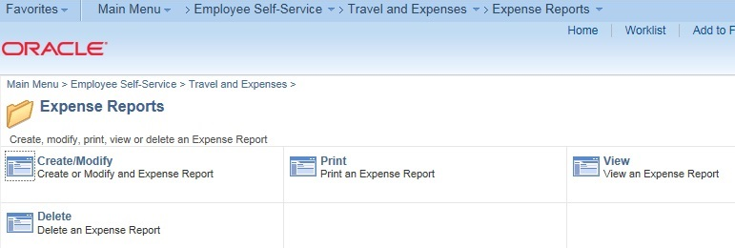
Working with Expense Reports
View
Modify
Print
Delete

Slide 14
Viewing Expense Reports
Can view Expense Report in any status:
  Pending (Saved but not yet submitted for approval)
  Submitted (For Approval)
  Pending Approval (An Approver has placed it on Hold)
  Approved (Ready for Payment Processing)
  Paid
Able to see where it is in the Approval path

Slide 15
Modify an Expense Report
Able to modify an Expense Report as long as it has not been submitted for approval
Must be in a “Pending” status
Once in Workflow, it cannot be modified
Withdraw an Expense Report
Able to withdraw an Expense Report after it has been submitted, as long as the DM1 has not acted upon it
Must be in a “Submitted” status
Once in Workflow, it cannot be modified

Slide 16
Print an Expense Report
Can print at any stage in the process
When printing, Expense Report opens as a PDF file in a new tab/window

Slide 17
Delete an Expense Report
May delete an Expense Report that has not been submitted for approval
Only Expense Reports in a “Pending” status may be deleted

