Slide 2
Career Planning is a life-long process
Discover
Experience
Prepare
Evaluate
You will prepare, discover, experience, and evaluate your career throughout your entire life.
The average U.S. worker changes jobs as many as 11 times throughout their life.
Your resume will continue to change and evolve, depending on the career path you are pursuing.

Slide 3
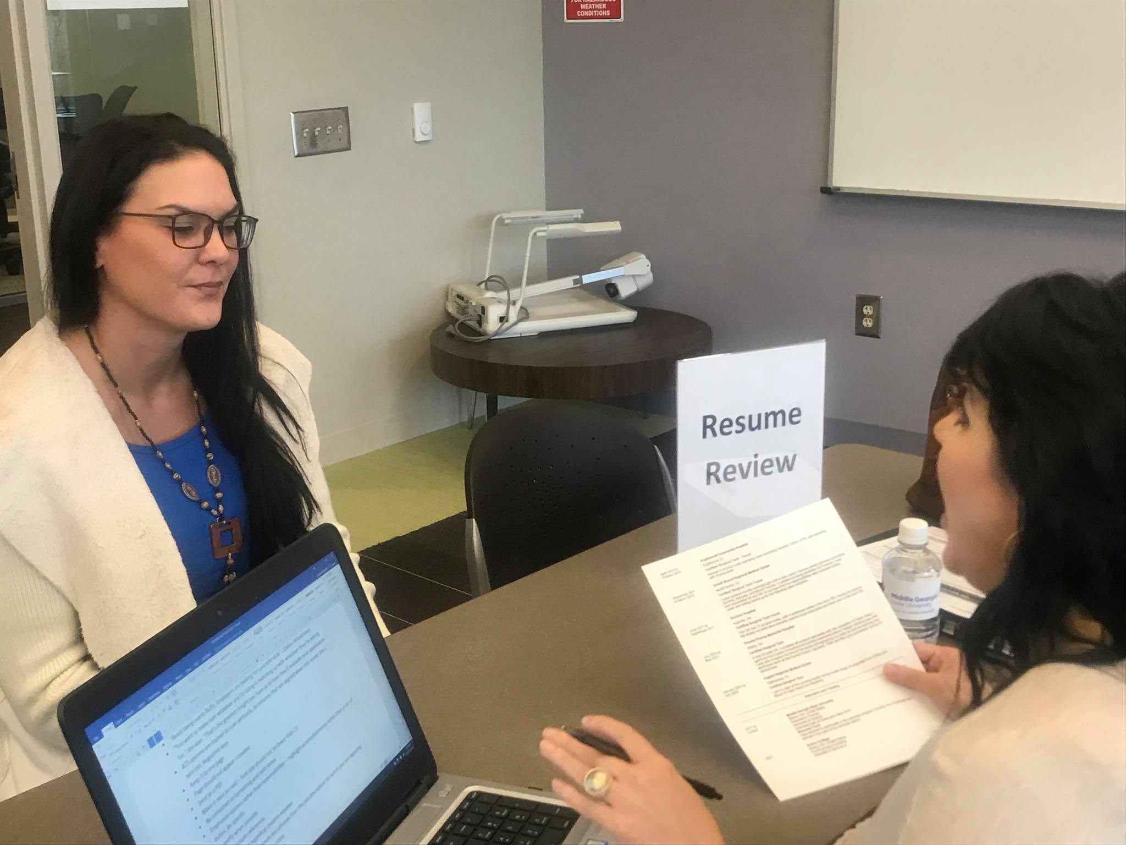
Purpose of a resume
Today’s instruction focuses on most industry job & internship search resumes
Graduate School, Research, Science, Education, Academia, or specific opportunities may want a Curriculum Vitae (CV) or longer resume
To get an interview (Not a job)
Provides overview of skills & experiences related to your goal - Should not detail everything
You may need a resume for internships, student leadership positions, volunteer opportunities, summer/part-time jobs, or meeting professionals in your desired field
Most employers look at resumes for less than 30 seconds!

Slide 4
What skills and experiences might be most important to the employer receiving resume?
If you don’t address what the employer needs, they may overlook you.
Consider the audience and match your resume to that specific position, person, or goal.
The goal is to get an interview!

Slide 5
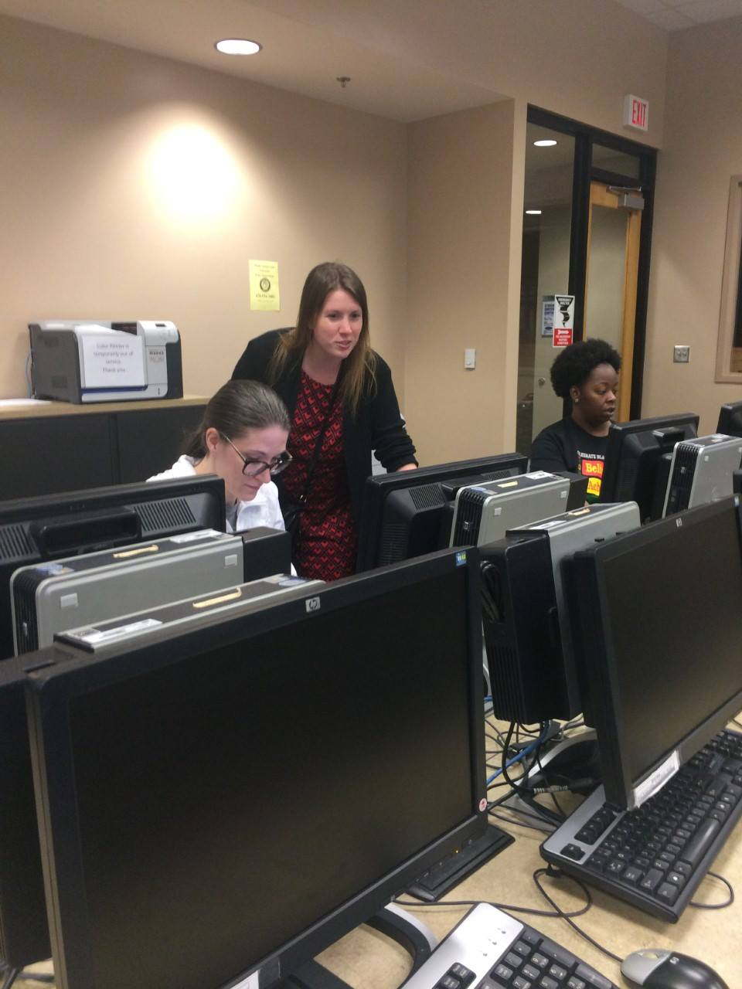
Resume basics
One Page – Why?
Where’s the “prime real estate” on a resume?
Include Your Major Assets
Your Degree
GPA?
Skills!
Technical knowledge/skills
Experiences (paid AND unpaid)
Honors/Awards
References are a separate document!
Notes:
We will be focusing on internship and jobs not research focus ( resume)
Still communicate skills in CV

Slide 6
Resume Format
Clean – Grammar & Spelling
Skills are Clear
Consistent
NO TEMPLATES!
Don’t use full sentences – fragments are okay!
Sections clearly labeled
Careful use of bold, italics, & underline
.5 – 1” margins & 10-12 font except name
Notes:
Information organized in a logical format with categories
Correct grammar and spelling
DO NOT USE AN ONLINE TEMPLATE!

Slide 7
Heading Section
You may also see headings where the job seeker:
Puts “Relocating to (insert city, state)” instead of an address
Includes a link to their LinkedIn profile
Objective Section
Use an objective to tailor the resume towards a specific application or to communicate a general career goal for a networking event.
Optional section, but encouraged for internship & entry-level resumes.
EXAMPLES
To obtain a summer nursing externship with Navicent Health
To use technical skills during a summer internship.
To obtain the Marketing Coordinator position with M16 Marketing

Slide 8
Education Section
Traditional Examples
Dual-Enrollment Examples

Slide 9
Education Section Tips
Always list it before “Experience” so the employer can see right away that you are working on your college degree
Your degree and major are two different things
Degree = Bachelor Arts, Bachelor of Science, Associate of Science, etc.)
Major = Nursing, Business, English, etc. (what you are studying)
Use the MGA website to ensure the correct wording for your degree and major
Tip: When writing your degree, it’s Bachelor or Associate of…. (don’t add an “s”!)
Include your GPA if it’s a 3.0 or higher
Make sure you list your university’s name correctly
Middle Georgia State University
For MGA, include your graduation month and year instead of dates attended
Include high school only if you are a current high school student

Slide 10
Experience Sections
Experience Tips
Choose categories that relate to your experience
Keep formatting consistent, even in new category
Within categories, most recent experience FIRST
Describe Your Experience
Use bulleted action phrases
Focus on skills and accomplishments rather than job duties you don’t want to do again
Use our list of action verbs For job –related experiences, include…
Typical Information to Include
Your title/role
Employer/ organization
Location (City & State)
Dates involved/employed (Month and Year only)
Where did you gain the skills necessary for your objective?
Class Projects
Relevant Coursework
Research Experience
Leadership Experience
Campus Involvement
Volunteer Experience
Work Experience
Presentations & Publications
Intercollegiate Athletics
Notes:
Possibilities of a experience
What ways
Paid vs unpaid
Lab project
Coursework
- Need good bullet points

Slide 11
Describing Your Experiences – Making Great Bullets!
Zaxby’s, Milledgeville, GA September 2013 – May 2015
Cashier
Worked with customers.
Zaxby’s, Milledgeville, GA September 2013 – May 2015
Cashier
Communicated with customers (100+ per shift) in a fast-paced restaurant ensuring order accuracy, fast service, and positive experience.
Action Verb (Skill Used)
Result (Impact)
Example (Described)
Bullet
1 or more bullet points per experience

Slide 12
Skills Section
Best for listing hard, specific skills such as…
Foreign language proficiency
Programming languages
Software skills
Technical skills
Laboratory skills
Medical skills
Do not list interpersonal skills such as leadership, communication, or hard working
Use your bulleted action phrases to show your interpersonal skills
More convincing within the context of a real work experience
Example

Slide 13
More about experience categories
Organizing Your Experience Categories
After “Education,” organize your categories based on what is most related to your objective
Additional Categories May Include
Military Experience (if not included in Work or Related Experience)
Professional Affiliations or Memberships
Honors & Awards
Intercollegiate Athletics
Study Abroad
Related Projects or Coursework

Slide 14
Using your Resume
Electronic Submission
Online Apps
Email
Mailing or In-Person
Resume Paper
BEWARE!
ATS – Resume Scanning Software
Keywords!
Follow Instructions!
USE PDF
Be honest and organized
May need a cover letter too – if optional, do it!
Templates with tables may not scan

Slide 15
Reasons to send a cover letter
Tips:
Don’t repeat your resume word-for-word
Avoid generic statements that do not speak to your specific skills
Use the job description to focus on 2 – 3 specific qualifications they are seeking that you have
Use the job description to refer to any duties, tasks, projects that relate to your past experience
Tells the employer why they are receiving your resume
Explains how your skills & experience are PERFECT for this specific job!
Shows your writing skills – an important skill for all jobs
Invites the employer to look at my resume, so they will call me for an interview.

Slide 16
Reasons to send a cover letter
When to Use
When Not to Use
What It Should Do
Emailing or mailing your resume
Career Fairs or Networking Events
Showcase writing skills
Emphasize interest
Applying online
Interviews (unless instructed)
Tell a story/example that summaries
Passing your resume on to a network contact
Invite the reader to review your resume

Slide 17
Structure of a cover letter
Business Letter Format
Use heading from resume
Address to a specific person or title
Dear Ms. _________
Dear Hiring Manager
Never use “Hello,” “Hi,” or “To Whom it May Concern.”
Best closing signature:
Sincerely or Best Regards
Paragraph 1
What you are applying for and why
Paragraph 2
Top skills and experiences that relate to the job you want
Paragraph 3
Conclusion indicating your interest in interviewing, provide contact information.

Slide 18
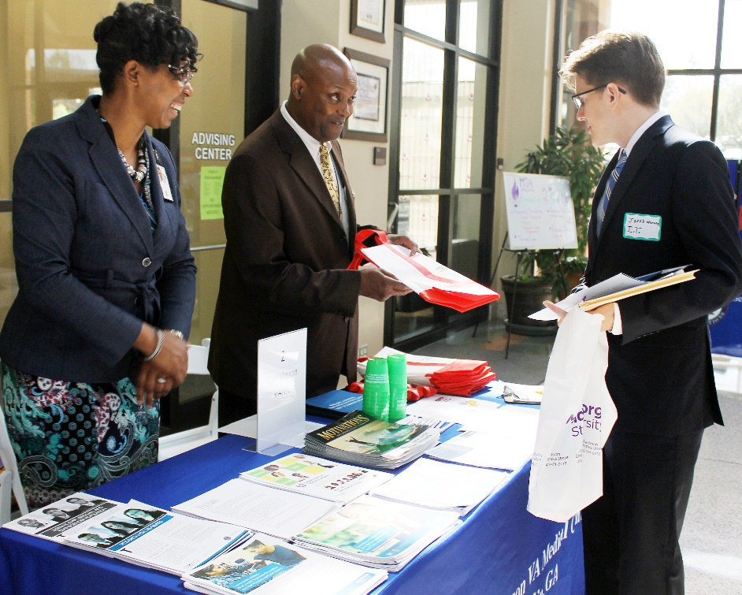
Next Steps
Update your resume.
Email us a copy to get feedback - careerservices@mga.edu
Upload your final copy to Handshake – MGA’s Career Platform mga.joinhandshake.com
Create a LinkedIn account using your resume information

Slide 19
Connect with us
Macon/Warner Robins Career Advisor: Student Life Center, Macon Suite 261⎟ 478-471-2714
Cochran/Eastman Career Advisor: Sanford Hall, Cochran Suite 112 | 478-934-3110
Dublin Career Advsior:
Office of Student Life Lib-94 | 478-275-6670
mga.edu/ccld
mgaccld
careerservices@mga.edu
Claim your Handshake account at mga.joinhandshake.com to find jobs & internships and connect with the CCLD
Email us to schedule an appointment in person, on the phone, or over email

