Slide 1
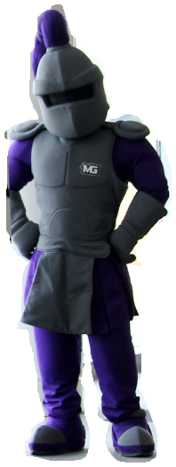
First Time Students and Seniors,
MGA Invites you to respond to the NSSE Survey to share your feedback about your undergraduate experience.
Check your MGA email starting March 15th, 2023
Take the
15-Minute
NSSE Survey!
NSSE Portal can be accessed via the link in your MGA email, online at our webpage https://www.mga.edu/institutional-research/data-reports/surveys/nsse.php, or through the published D2L widget and announcements.
NSSE = National Survey of Student Engagement
Student responses to NSSE questions will
help our university and departments learn:
The quality of interactions with other students and faculty.
What you’ve gained from your classes.
Activities you’ve participated in inside and outside class.
Seniors: Your post-graduation plans.

