Slide 1

P-Card Training FY23
Amy Ingram
P-Card Administrator
Phone 478-934-5024
EMAIL: Amy.ingram@mga.edu
Christy Colvin
Director of Finance
Phone 478-757-3602
EMAIL: Christy.colvin@mga.edu
FAX 478-471-2097

Slide 2
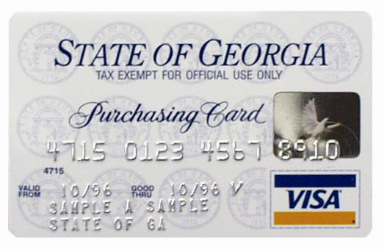
Use of the Purchasing Card
All transactions made using the State of Georgia Purchasing Card must benefit and support the University’s mission of education, research, and public service.
Purchases made with the Purchasing Card have to follow State of Georgia Purchasing Guidelines and Procedures.
The Purchasing Card is a privilege that is granted to certain employees of Middle Georgia State University.
Purchases for personal use or benefit should never be made with the purchasing card.

Slide 3

WHERE TO GET HELP
Contact P-card Administrator:
Phone: 478-934-5024 EMAIL: Amy.ingram@mga.edu
Contact Backup P-card Administrator:
Phone: 478-757-3602 EMAIL: Christy.colvin@mga.edu
BANK OF AMERICA
To report a lost/stolen card call 1-888-449-2273.
Notes:
DISPUTE
To dispute a transaction that has appeared on your statement:
When a cardholder discovers that an incorrect amount has been charged for goods received, or a questionable purchase or transaction appears on a cardholder’s memo statement, the cardholder must immediately seek to resolve the problem with the vendor. If no resolution can be made, the cardholder can dispute the transaction online in the Works software application. The cardholder can find instructions in the User Guide on page 97 under “Disputing a Transaction”. If cardholder experiences any problems with the procedure, they can contact the Purchasing Card Coordinator for assistance: 757-3602

Slide 4
Changes to p-card police effective April 1, 2017
P-card is no longer the preferred method of procurement small value items – Epro is to be used whenever possible
Pre-Approval Process – two signature requirement – budget approver and fiscal approver
Credit Check – initial and at time of card renewal
  Score provided – either pass or fail
Notes:
Please do not Circumvent the procurement process.

Slide 5
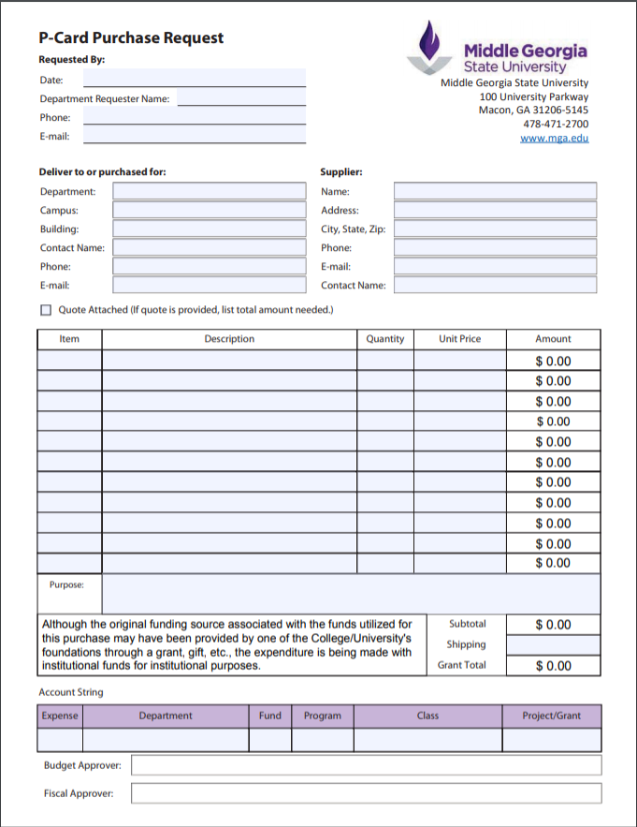
Pre-Approval Requirement
Required for all purchases with p-card unless the following applies:
Special Exemption granted
Emergency
Under $1000 – unplanned, non-routine, or urgent point of sale purchases
Written explanation required to be submitted with p-card reconciliation for any p-card transaction that is not supported by the approved p-card purchase request

Slide 6
Unplanned, non-routine and urgent point of sale p-card transactions
Purchases such as office supplies do not meet this requirement e.g. ink cartridges
If in doubt – complete the p-card purchase request form and have it approved prior to purchase
Regular p-card transactions should not be unplanned, non-routine or urgent

Slide 7

Order of Precedence
The Order of Precedence provides you with a list of sources you must use to determine if the commodity or service you are trying to acquire has already been negotiated and must be purchased from the source.
Must be followed in this order:
1. Mandatory Statewide Contracts
2. Existing State Entity Contracts
3. Statutory Sources:
Products Certified as Mandatory by the State User Council, which includes some products provided by the Georgia Enterprises for Products and Services (“GEPS”)
Georgia Correctional Industries Administration products which have been certified as Mandatory by the Commissioner of the Department of Corrections (“GCI”)
4.Choice of 5 as:
Convenience Statewide Contracts
GEPS Preferred Products (i.e. those items not certified as mandatory)
SPD Pre-Approved Piggyback Purchases
SPD Pre-Approved Consortia and Cooperative Purchasing
Open Market Purchases

Slide 8
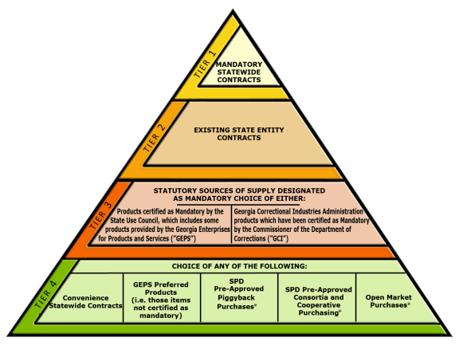
Order of Precedence
Xerox
Custodial Services
Convenience Statewide Contracts: Staples, Grainger, & SCW
Open Market Purchases: Amazon

Slide 9
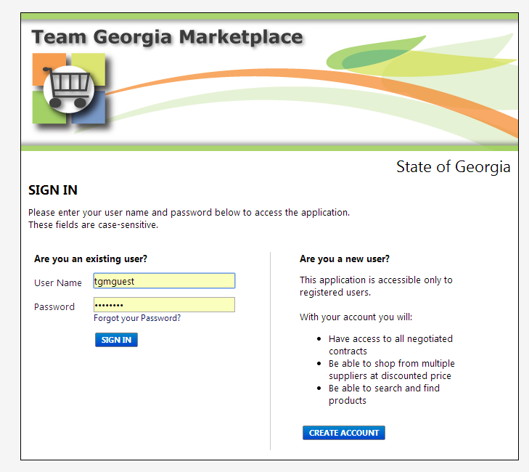
Team Georgia Marketplace
To look up statewide contracts you can utilize the Team Georgia Marketplace Window Shopper website. Please keep in mind that statewide contracts are changing. Some will be renewed and may have a new number, some may be discontinued. Other statewide contracts may be created for the first time.
Access the site at:
https://solutions.sciquest.com/apps/Router/Login?OrgName=Georgia
User Id and Password: tgmguest

Slide 10
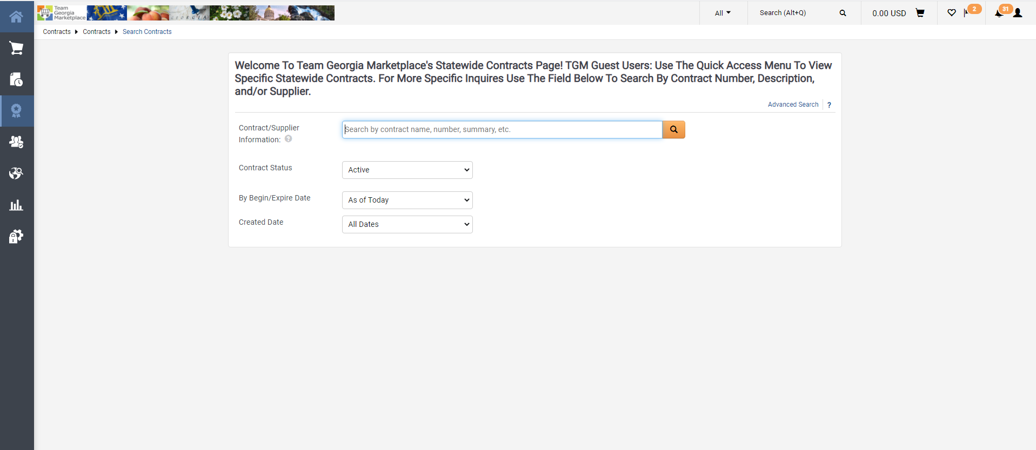
You can find contract items
Look up by keyword
You can look up statewide contracts
If you leave the search box blank and just click ‘go’ all statewide contracts will display

Slide 11
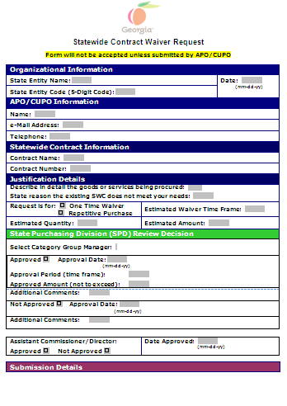
If you research the product you would like to purchase
and you find that you could obtain the same item from a source
not on statewide contract at a lower cost or faster,
but the contract is mandatory
please contact me to process a
Statewide Contract Waiver Request
before you make the purchase.
I will submit the request to
Process Improvement and most
of the time I receive an approval.
This process does require additional
time and effort and may not always
be feasible. Please contact
Amy Ingram to discuss on individual
case basis.

Slide 12
Allowable Purchases
Following State Purchasing Guidelines and Procedures:
Supplies and materials
Software
Single Equipment Purchases under $2,999.99
Subscriptions
Memberships
up to the cardholder’s approved Single Transaction Limit (including shipping, handling, etc.)
Do not split transactions between one or more cards or create multiple transactions with the same vendor to circumvent
the Single Transaction Limit!!!

Slide 13
Prohibited Purchases
NO PETROLEUM
NO PERSONAL PURCHASES
(There is a Merchant Category Code [MCC] restriction on all College Purchasing Cards that specifically restrict the purchase of cash advances).

Slide 14
Purchasing within the School
Do not use your p-card to make purchases at the Bookstores, Cafeteria, or Conference Center.
To make purchases at the Bookstore please fill out the requisition form for internal purchases. http://www.mga.edu/campus-store/docs/Purchase_Requisition_Form.pdf
To make purchases at the cafeteria or with catering, complete the catering request and enter a requisition into ePro.
To make purchases with the Conference Center send the completed registration form to Accounting Services and they will journal the charge.
Please send completed registration forms with department chart-field information to christy.colvin@mga.edu.

Slide 15

Chip & PIN
How does a chip credit card work?
It's easy. If the retailer has a chip-enabled terminal, simply insert your chip card face up in the terminal. The chip card will remain in the terminal while the transaction is processed. To authorize your transaction, just follow the prompts on the terminal as you do today.
You'll be prompted for a signature to complete the purchase, you may be asked to provide a PIN. Should this occur, just enter the credit card PIN assigned to your card. Your card is available to be removed from the terminal once the transaction is completed.
If the retailer is not equipped to read the chip card, just swipe as you do today. For transactions made over the phone or online, nothing changes.
What is Chip & PIN?
The term "PIN" simply refers to how you will authorize the transaction – by entering a PIN. When using your Bank of America chip credit card, you'll be prompted for a PIN to complete the transaction. Should this occur, just enter the credit card PIN assigned to your card.
The enhanced security against counterfeiting is contained within the chip itself. The chip makes the transaction more secure by encrypting information when completing a transaction at a chip-enabled terminal. As a result, Chip & PIN transactions offer enhanced security against counterfeiting.

Slide 16
Disputing a Transaction
When a cardholder discovers that an incorrect amount has been charged for goods received, or a questionable purchase or transaction appears on a cardholder’s memo statement, the cardholder must immediately seek to resolve the problem with the vendor.
If no resolution can be made, the cardholder can dispute the transaction online in the Works software application within 60 days. The cardholder can find instructions in the Program Manual under “Disputing a Transaction.” Link to dispute form: https://www.mga.edu/procurement/docs/Dispute_Form.pdf
If cardholder experiences any problems with the procedure, they can contact the Purchasing Card Administrator/Coordinator for assistance:
478-934-5024 Amy.ingram@mga.edu or 478-757-3602 Christy.colvin@mga.edu.

Slide 17
Emergency Purchases
An emergency situation exists in cases where the welfare of the general public is at stake e.g. extreme weather conditions, or official declared emergencies

Slide 18
SALES TAX EXEMPTION
It is the responsibility of the cardholder to ensure that sales tax is not charged when making a purchase with the Purchasing Card. If tax is charged in error the cardholder must request a credit from the supplier as soon as possible after discovering the error.
The embossed line on the Purchasing Card reads “State of Georgia”. The University is exempt from ALL sales taxes but it is the cardholders’ responsibility to provide vendors with the sales tax exemption form.
The cardholder can contact the Purchasing card Administrator for a copy of the Sales and Use Certificate of Exemption. Amy.ingram@mga.edu

Slide 19
P-card Reconciliation
Cutoff/Deadlines For Purchases/Reporting
Monthly cutoff for cardholder purchases posted 27th of each month
Procurement card statement issued to cardholder 5th of each month
WORKS sign-off completed by 27th of each month
Approved Reconciliation upload to server with both signatures 15th of each month
Weekly/Monthly Transaction Review: In the Works application (web based software used for reconciliation and reporting); the cardholder will be emailed after each transaction has been posted to their credit card. The cardholder will be responsible for reviewing and reconciling transactions weekly. Sign off in WORKS has to be completed by the 1st of the following month.
The p-card holder shall include a monthly purchasing card log as part of his/her reconciliation package. In addition, the reconciliation package must include the p-card statement and the backup documentation for each charge.
Link to Monthly Log: https://www.mga.edu/procurement/documents.php

Slide 20
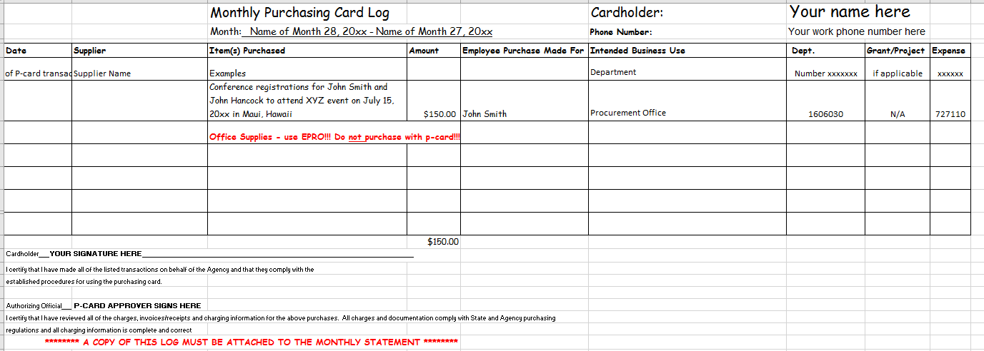
Monthly P-Card Log

Slide 21
DOCUMENTATION REVIEW
PURCHASES OF SUPPLIES AND MATERIALS
There is no one right definition of adequate documentation for all transactions. The nature of the goods or services received determines what information the invoice or receipt must contain.
However, all invoices should contain basic information about the transaction.
These are:
• Vendor or merchant name
• Transaction date
• Line item information
  Quantity
  Description
  Unit Price
  Line Price (quantity times unit price)
• Total invoice amount
• Attestation of receipt of goods or services
If the documentation is a cash register receipt, then the cardholder’s signature should be on it.
If the items were shipped, the receiving employee should sign the packing slip, and the invoice if it comes in the shipment, and send to the documentation to the cardholder. The cardholder should keep the original, signed packing slip and invoice with the transaction log or monthly billing statement.
Shipping addresses should be to the school addresses only.

Slide 22
Specialized Transactions
In addition to the above information, good accounting practices dictate that certain
transactions have the following documentation:
Subscriptions (Newspapers, magazines)
• Length of subscription or renewal
• Name of periodical
• Name of employee for whom periodical was ordered
• Delivery address for the periodical
• Cardholder should sign original order or renewal form
Organizational Memberships
• Name of employee for whom the membership is paid
• Length of the membership period
Printing
• Copy of finished product
• Job order or other document showing the number of documents printed

Slide 23
Add p-card reconciliation to shared network drive
Save p-card statement, p-card monthly log and supporting documentation as one pdf (Adobe) file
Name it: Last name, First Initial of First Name – Month of transaction & year
Example: Stefano, S Oct 2022.pdf
Map shared network drive: Pcard_Reconciliations$
Find correct monthly folder and save:
  Example: 01 Oct 2022 Transactions
Make sure you signed off on your transactions in Works
Verify all documentation has been submitted
The complete electronic p-card reconciliation must be uploaded to the server by the 15th of each month.

Slide 24
Reminder for P-Card Reconciliation
Make sure that no sales tax is added to your purchases.
Review the p-card manual for allowable purchases and prohibited purchases.
The signatures of the p-card holder and the authorizing official by the 15th of each month are required on the p-card statement and on the monthly purchasing card log.
Allocate your chart field strings in Works and sign-off weekly.
Add comments for each transaction describing the purchase.
Upload your monthly p-card reconciliation no later than the 15th of each month to the Pcard_Reconciliations$ server.
Make sure that you have proper documentation for each transaction including the pre-approved p-card purchase request form

Slide 25
Reminder for P-Card Reconciliation
AUTHORIZING OFFICIAL
The Authorizing Official is responsible for the following:
Approval Review:
Each Authorizing Official is responsible for ensuring all items purchased by an employee have been approved and has the signature of the card holder and authorizing official on the bank statement and monthly log. The Authorizing Official’s signature confirms that sufficient funds are available.
Budget Review:
Authorizing Officials are responsible for ensuring sufficient funds are available for all items purchased within his/her Division/Department.
Review of Monthly Cardholder Reconciliation:
The Division/Department heads are responsible for ensuring that monthly statements are verified to supporting documentation and are accurate. The statement cutoff date is the 27th of each month.

Slide 26
Resources
Georgia Procurement Manual online http://doas.ga.gov/state-purchasing/law-administrative-rules-and-policies
Department of Administrative Services (DOAS) http://doas.ga.gov/
State of Georgia P-card policy http://doas.ga.gov/assets/State%20Purchasing/PCard%20Marketplace%20Documents/PCard_Policy.pdf

Slide 27
Questions?

