Slide 1
Building Coordinator Training Cochran Campus 2025

Slide 2
Building Coordinator responsibilities
Serve as the building contact during regular business hours
Understand the appropriate safety measures and who to contact in an event of an emergency
Aid in the safety of students, faculty, and staff present in your designated building/floor
Become familiar with the evacuation and assembly areas both inside and outside of your building

Slide 3
Building Coordinator Positions
Primary
Serves as first point of contact
Alternate
If one is selected, acts as emergency contact in the absence of Primary Coordinator
3rd Backup
Plant Operations or University Police

Slide 4
Snow, ice, or flooding
Severe weather / natural hazards
Can make travel to or from campus hazardous
University Police will determine if campus activities should be suspended
Faculty, staff, and students will be notified through campus notifications and news releases
University Police will continually monitor weather, news, and road conditions

Slide 5
Earthquake
During Shaking:
Seek refuge in a doorway or under a desk or table
Stay away from glass windows, shelves, and heavy equipment
Do not run through or near buildings
After Shaking:
Evaluate the situation and determine if emergency help is necessary. If so, call University Police (478) 934-3002 or 911.
Report damaged facilities to Plant Operations (478) 934-3000

Slide 6
Tornadoes
Watch: possibility of one or more tornadoes in the area. Continue with normal activity but monitor weather.
Warning: a tornado has been sighted and may be approaching. Seek shelter immediately.
Seek shelter in the lowest level of the building
shelter locations
Get under a heavy desk or sit next to the wall and cover your head with your arms/hands
Do not waste time opening windows or doors to equalize air pressure – could cause explosion if a spill has occurred

Slide 7
Thunderstorms
Can bring heavy rain, hail, strong winds, and occasionally snow
Lightening during dry periods can start fires
Watch: conditions are favorable for severe weather. Continue normal activities, but monitor weather closely.
Warning: seek shelter immediately in predesignated area of the building and monitor conditions until storm passes
Stay away from windows
Do not use electrical appliances

Slide 8
Bomb threats
DO NOT HANDLE the object you observe as a suspicious object or potential bomb
Clear the area immediately and call University Police (478) 934-3002 or 911
If your building is not evacuated:
Police may lead a search of the area
If your building is evacuated:
Follow evacuation protocols – assembly areas indicated in this presentation and in your handbook
Once outside, stay away from buildings, vehicles, and trash containers
Police will lead search of the area

Slide 9
Hazardous material spills
Any spillage of a hazardous chemical should be reported to Facilities at (478) 471-2780 during normal working hours or University Police (478) 934-3002 after hours.
Reporting:
Be specific about the material involved and approximate quantities
The Facilities department will initiate the response of appropriate response teams to effectively clean up the spill
Vacate the area and seal it off to prevent further contamination of other areas until response teams arrive
If evacuation of the building is required, follow evacuation proto

Slide 10
Oil spill
Notify all:
University Police (478) 934-3002
Plant Operations (478) 934-3000
Extinguish all sources of ignition and remove all vehicles from spill area
The SPCC plan for Cochran can be found online
Spills greater than 10 gallons:
If can be done safely, attempt to stop release and deploy spill response materials
SPCC Coordinator will notify authorities and response contractor to assist in cleanup
Spill less than 10 gallons:
Contain spill with absorbent material
Recover spilled material using absorbent materials
SPCC Coordinator will arrange for proper disposal of waste materials

Slide 11
Natural gas leak
Natural gas has an odorant added to make it smell like rotten eggs
A flame or spark in the area could cause an explosion
If you smell a natural gas odor:
Do not try to locate the leak
Evacuate the building
Do not open windows
Do not use any devices that could cause a spark
Once outside, move at least 150ft away from building
Activate fire alarm outside the area of the leak
Call University Police (478) 934-3002 or 911

Slide 12
Fires
Report to University Police (478) 934-3002 or 911
Minor Fires:
Charge fire extinguisher toward base of the flame
Large Fires:
Activate building alarm
Evacuate and do not use elevators
Close all doors while exiting building (Do not lock doors)
Be prepared to stay near the floor while exiting if smoke is present
Direct crowds away from fire hydrants and road ways – clear sidewalks
Ask bystanders to watch windows for trapped persons
DO NOT attempt to rescue anyone. Notify fire department personnel.

Slide 13
Active shooters
Immediate life-threatening event:
Notify University Police (478) 934-3002 or call 911
Each individual should take whatever actions necessary to protect his or her own life
If possible, flee the area safely and avoid danger
Lock or barricade all doors
Remain in place until “all clear” is given by law enforcement
Someone observed a weapon on campus:
Remain calm and call University Police (478) 934-3002
Do not touch the weapon or approach the individual
If possible, remove yourself from area

Slide 14
Evacuation and assembly
Evacuations will occur when an alarm sounds or upon notification by MGA officials
Leave by emergency evacuation route predesignated for your area
Depending on the emergency, you may need to stay in or exit the building

Slide 15
Severe weather shelter areas
The following diagrams are the severe weather shelter areas for each building on the Cochran campus.
These locations are on the main level away from windows and doors. Shelter areas are highlighted in yellow.
These areas can also be accessed online

Slide 16
Notes:
Admissions

Slide 17
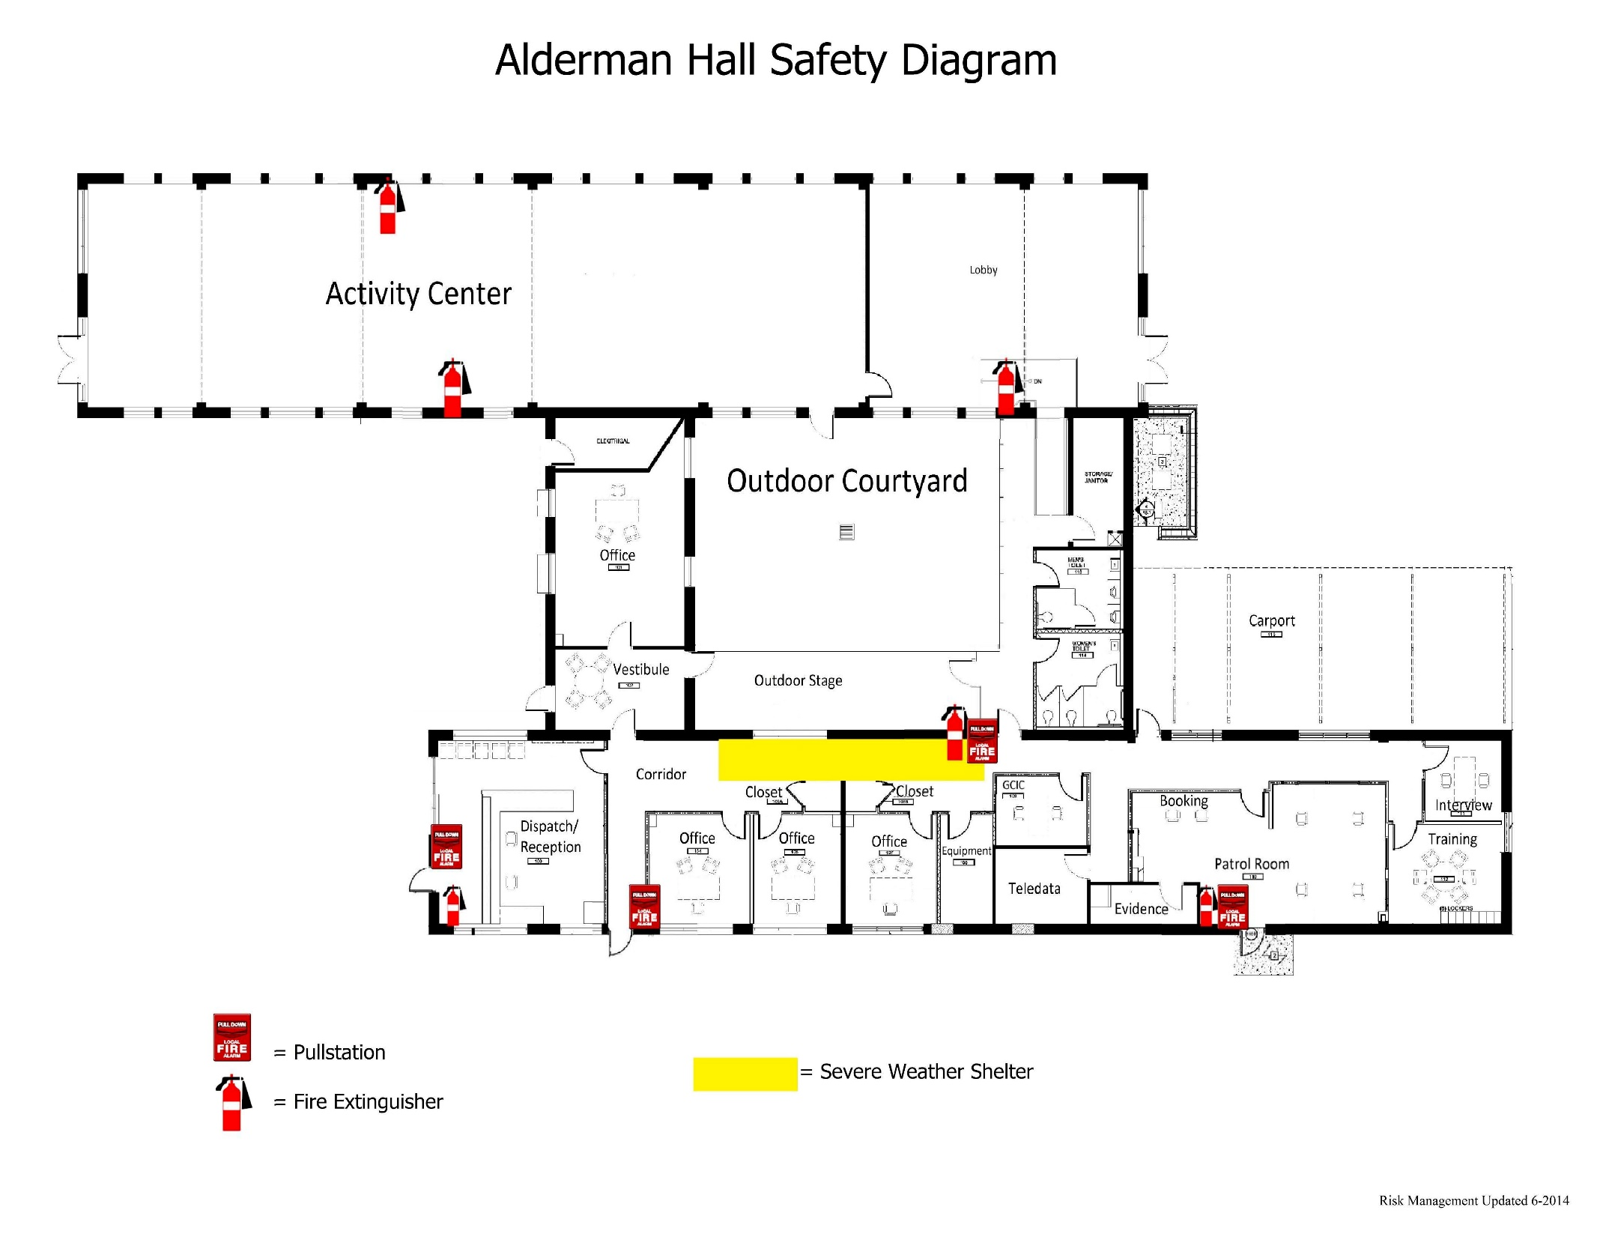
Notes:
Alderman

Slide 18
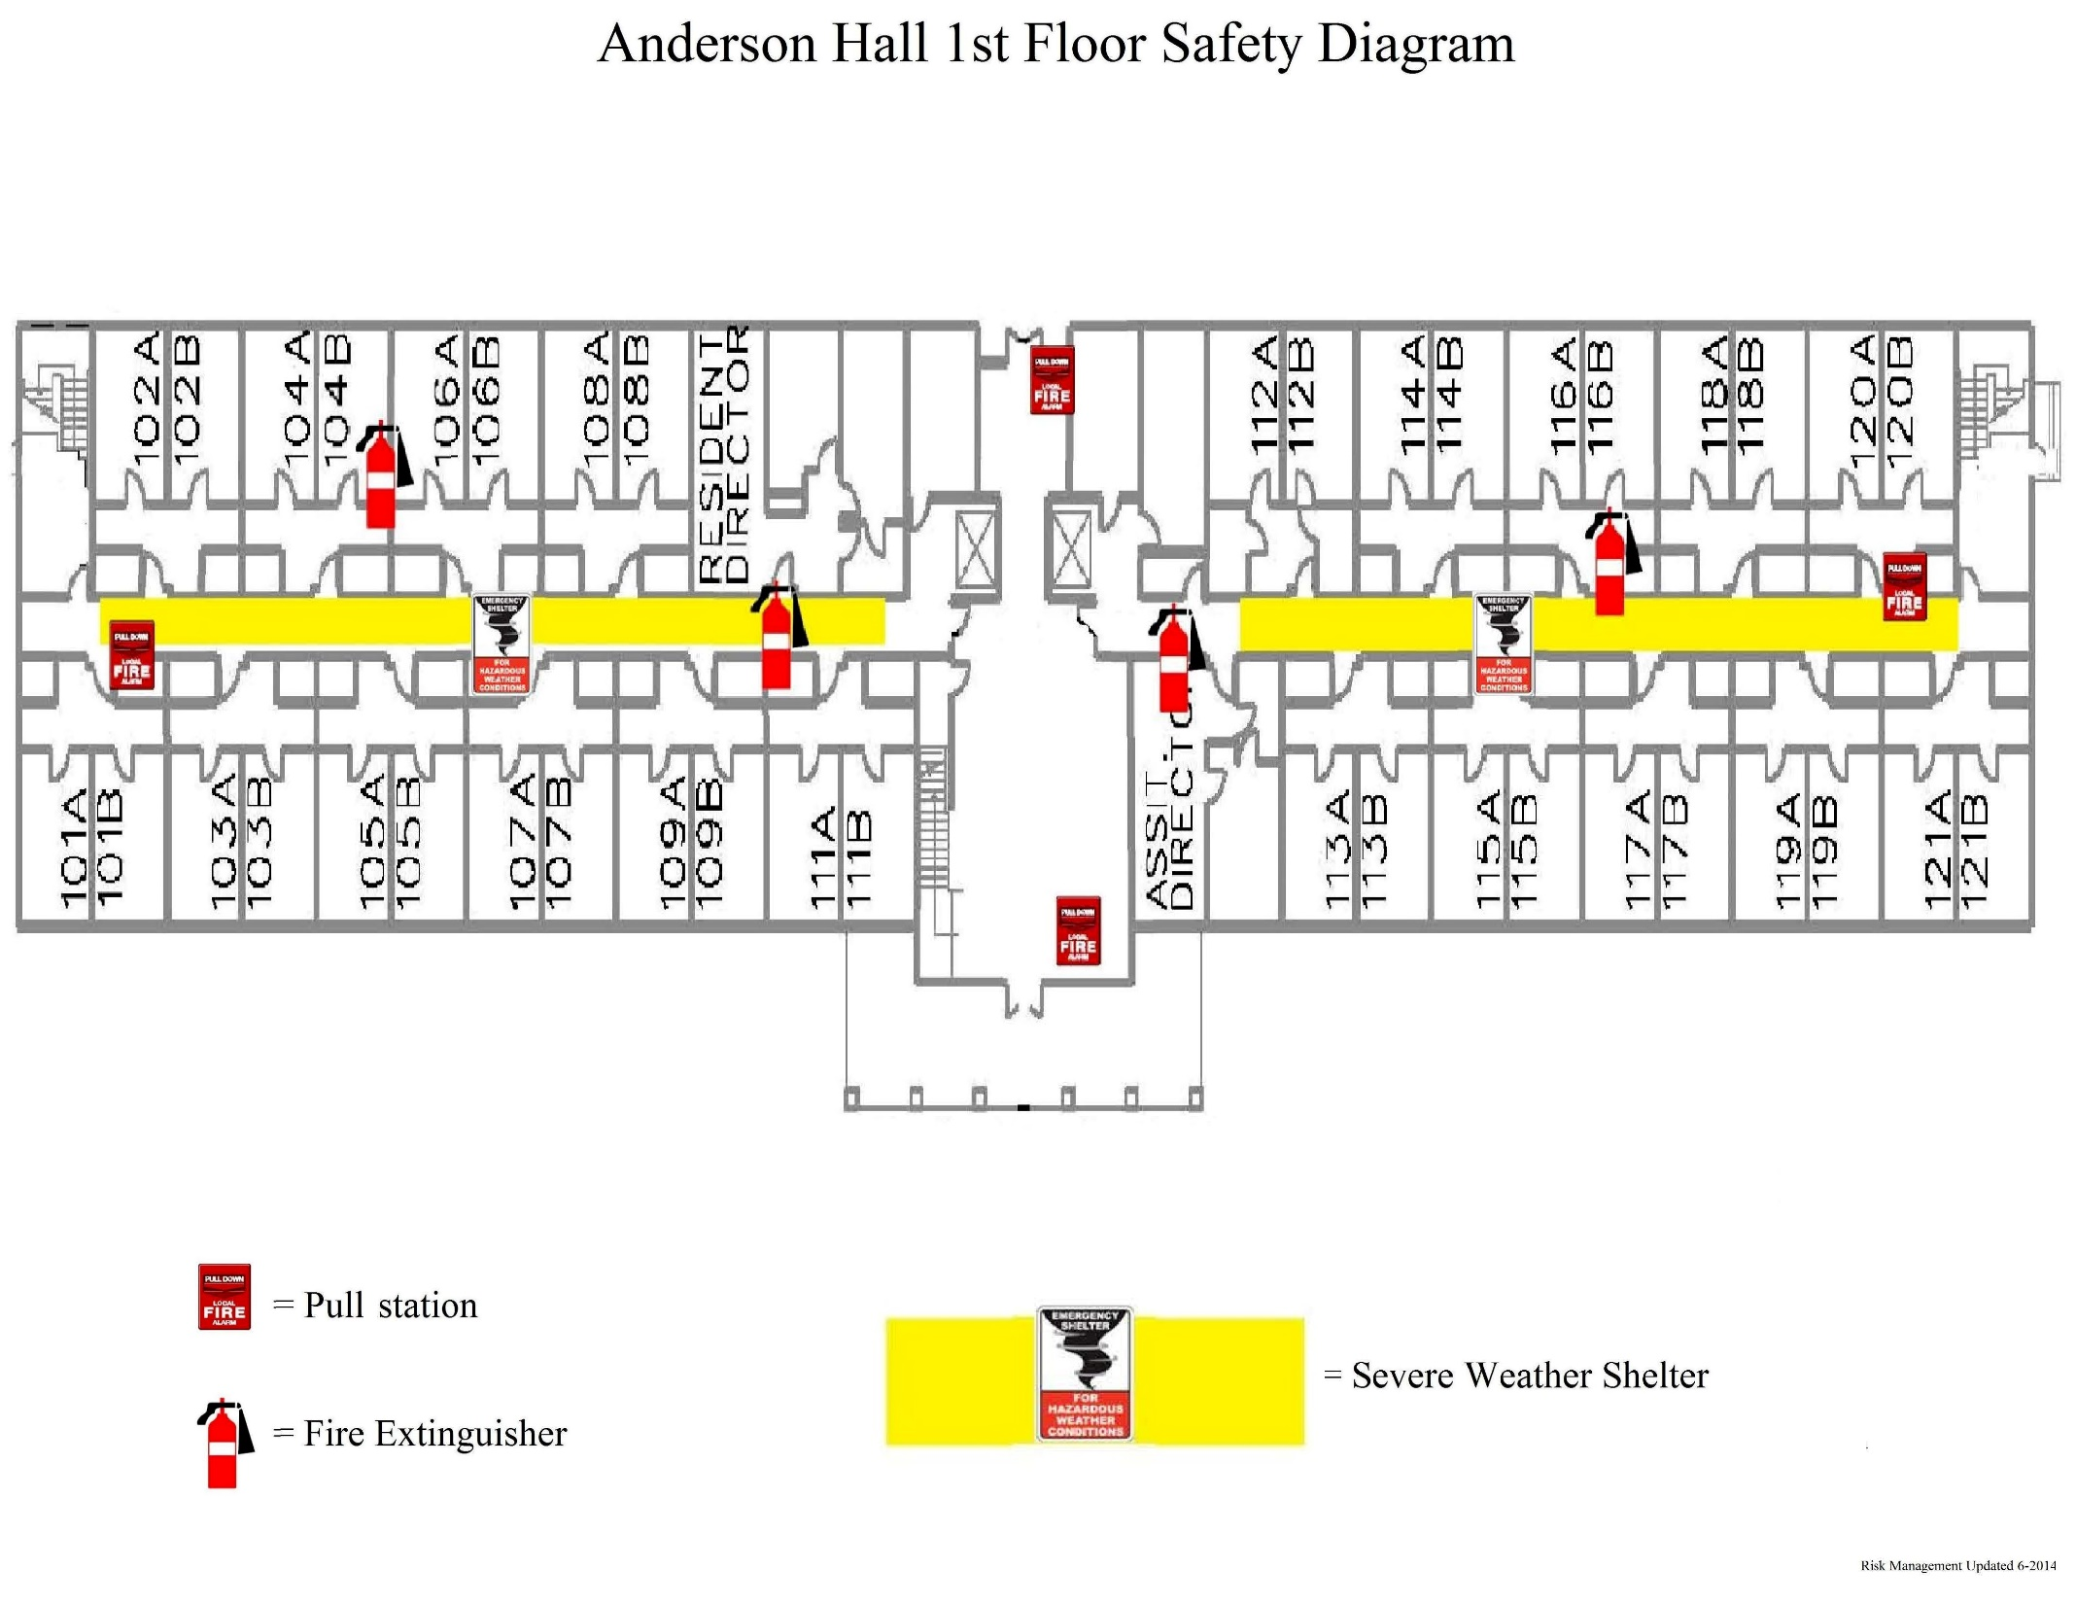
2nd and 3rd floors will assemble on 1st floor
Notes:
Anderson

Slide 20
2nd floor will also assemble on 1st floor

Slide 22
2nd floor will also assemble on 1st floor

Slide 23
Addition will also assemble on 1st floor of main building

Slide 24
2nd floor will also assemble on 1st floor

Slide 25
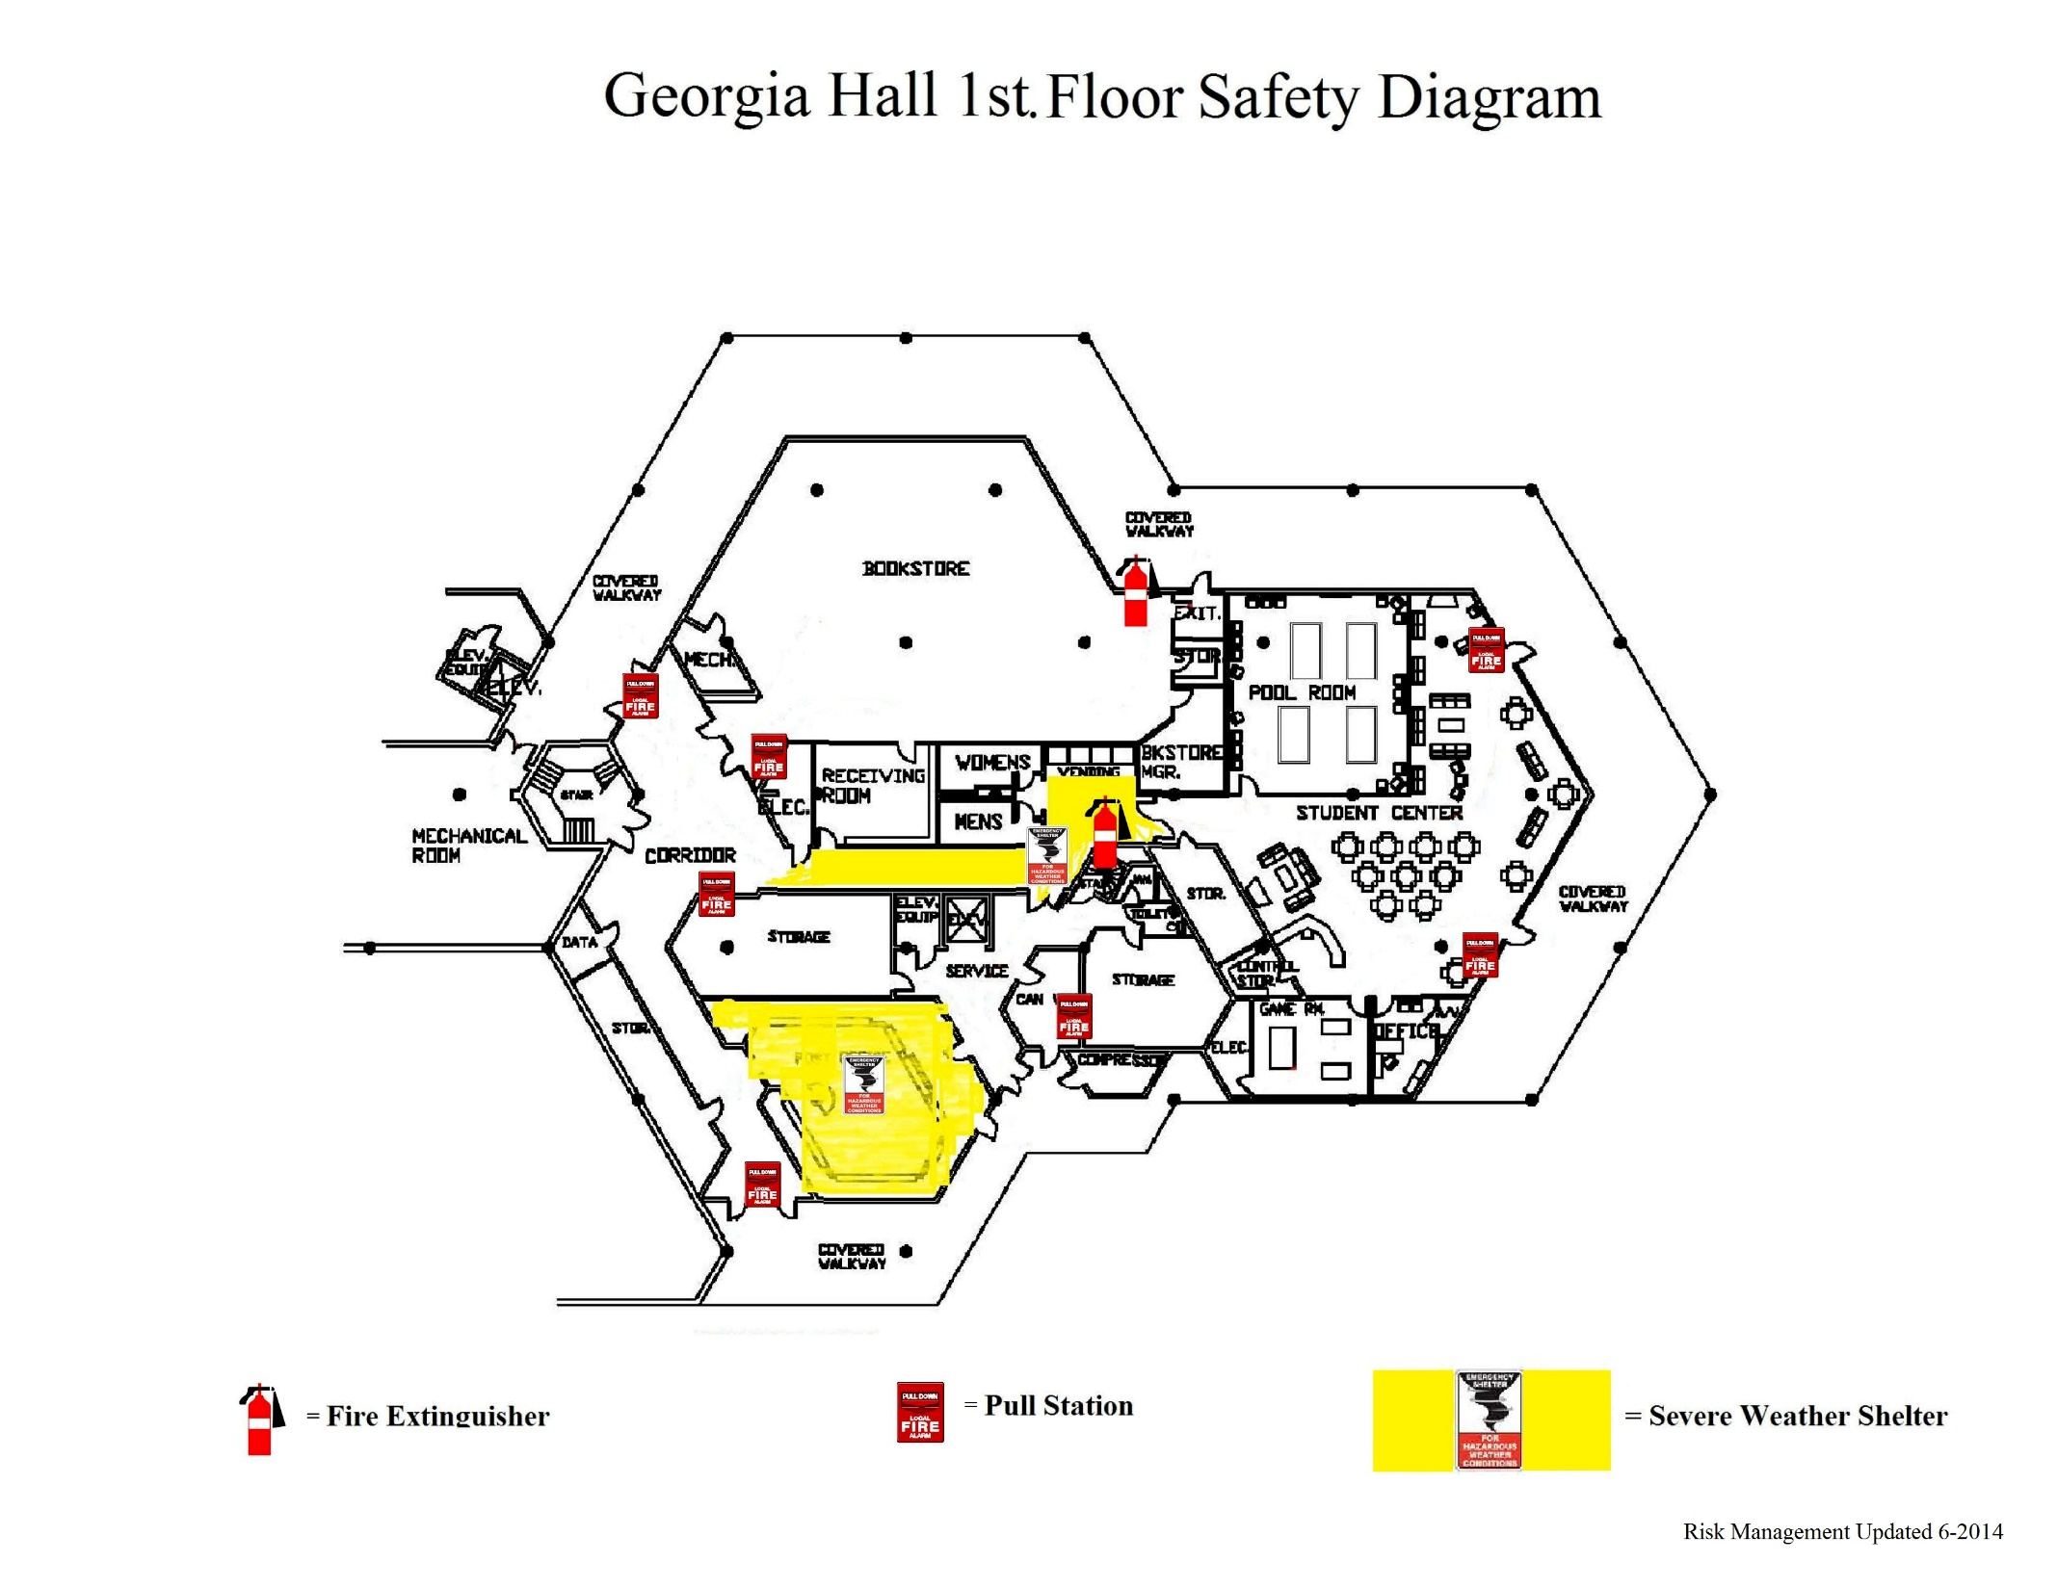
2nd floor will also assemble on 1st floor

Slide 26
1st and 2nd floors will also assemble on ground floor

Slide 27
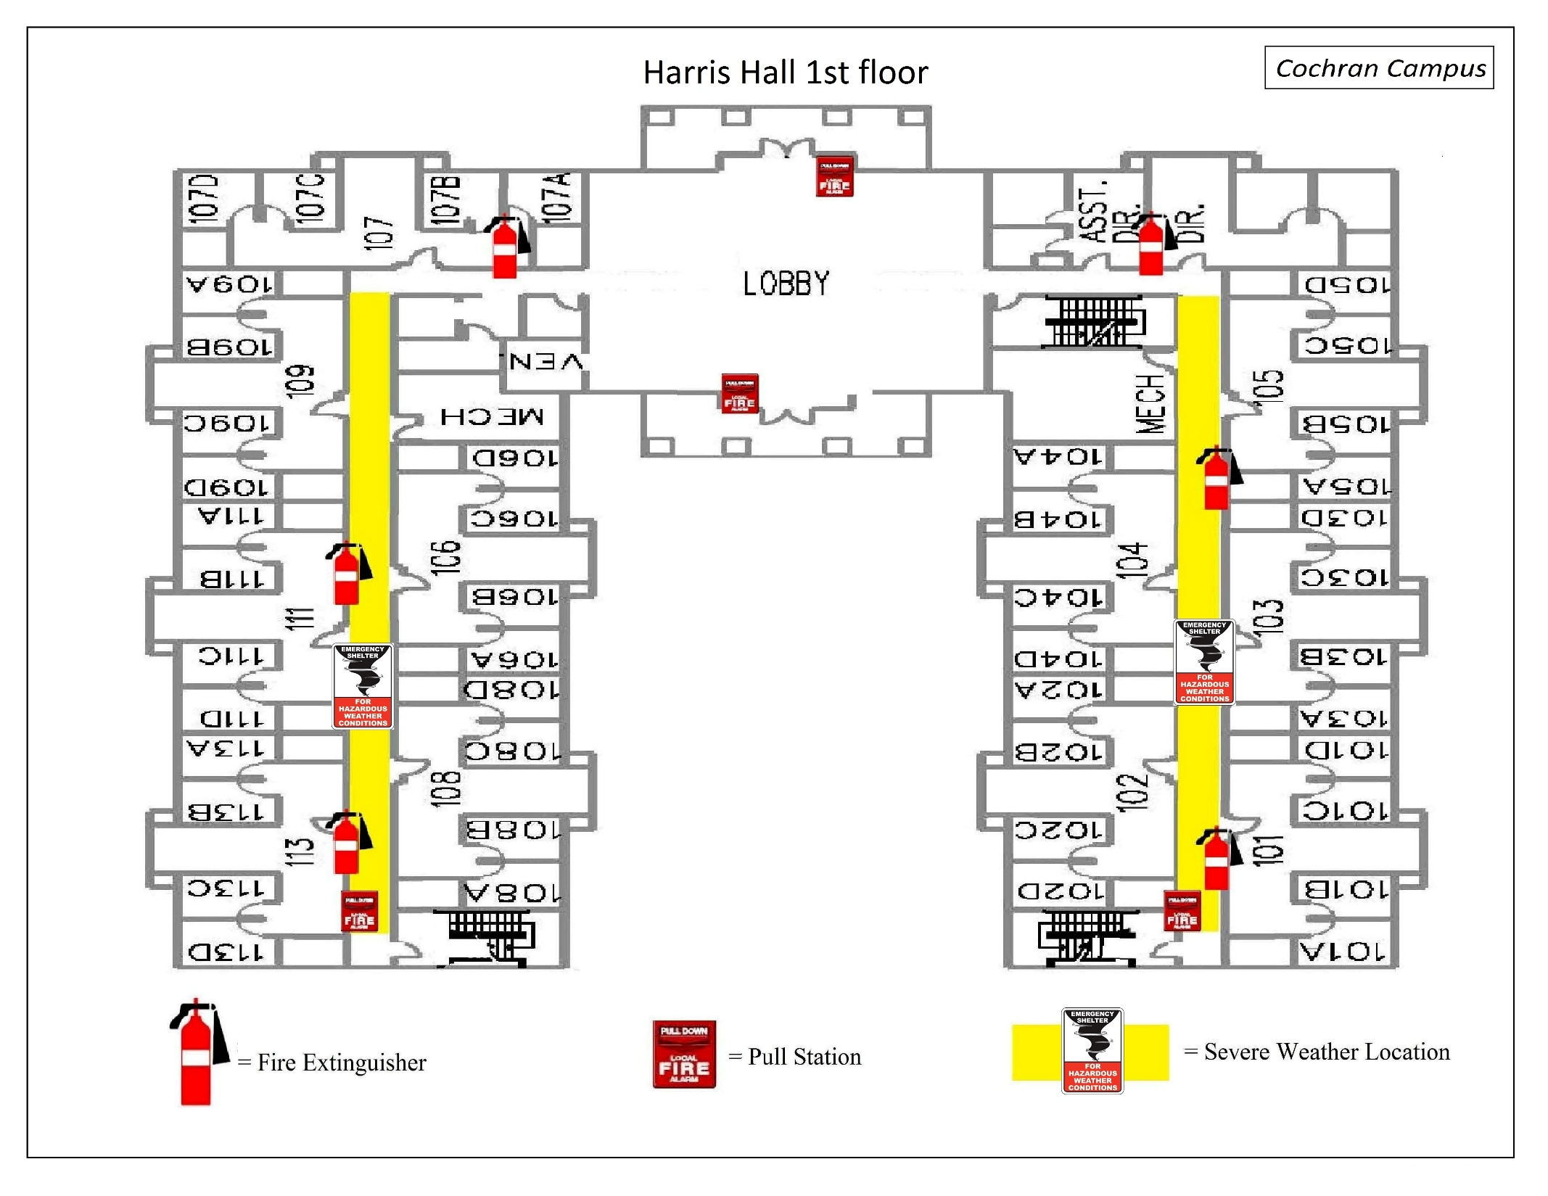
2nd and 3rd floors will also assemble on 1st floor

Slide 28
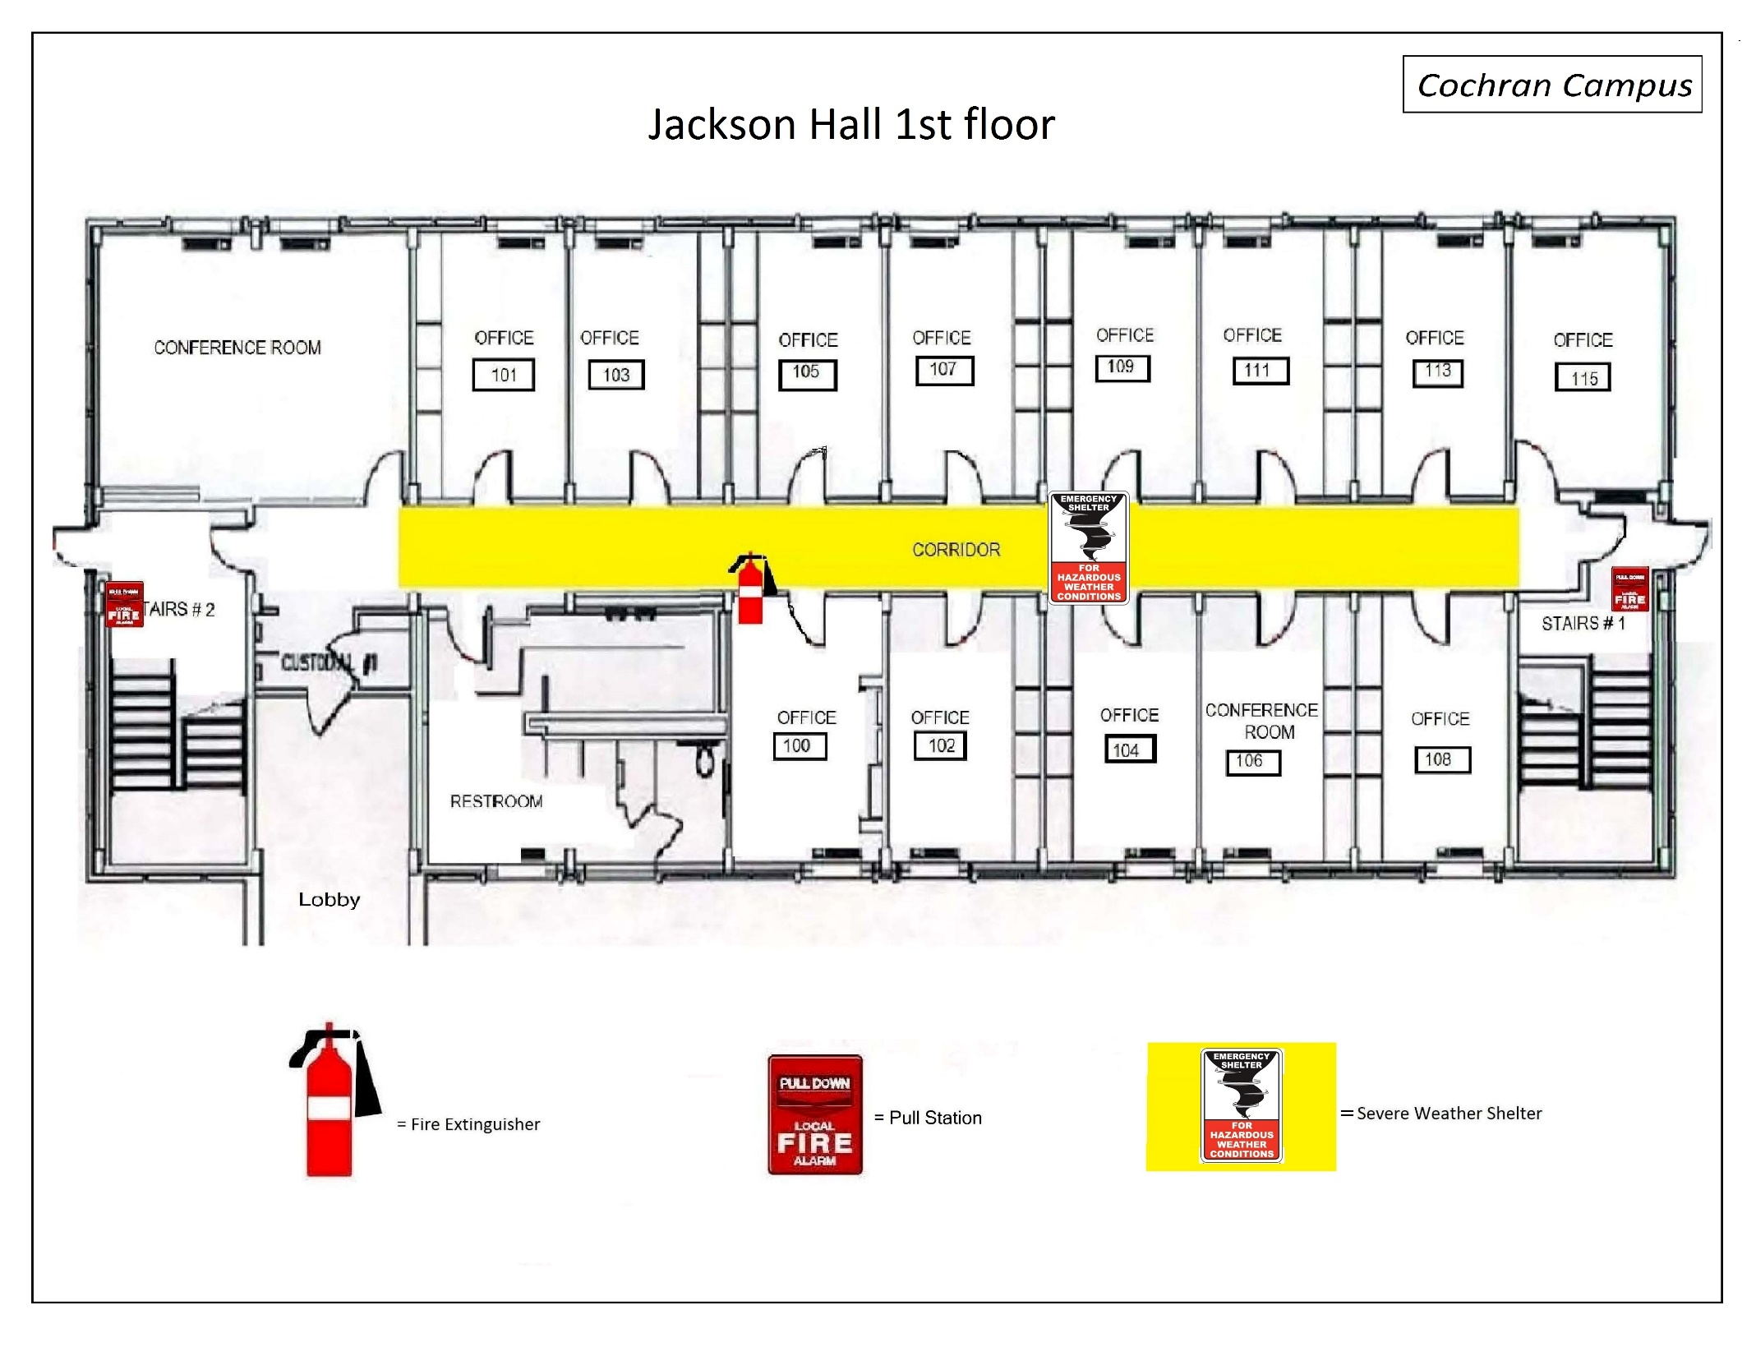
2nd floor will also assemble on 1st floor

Slide 29
1st floor will also assemble on basement floor

Slide 30
1st floor will also assemble on ground floor

Slide 31
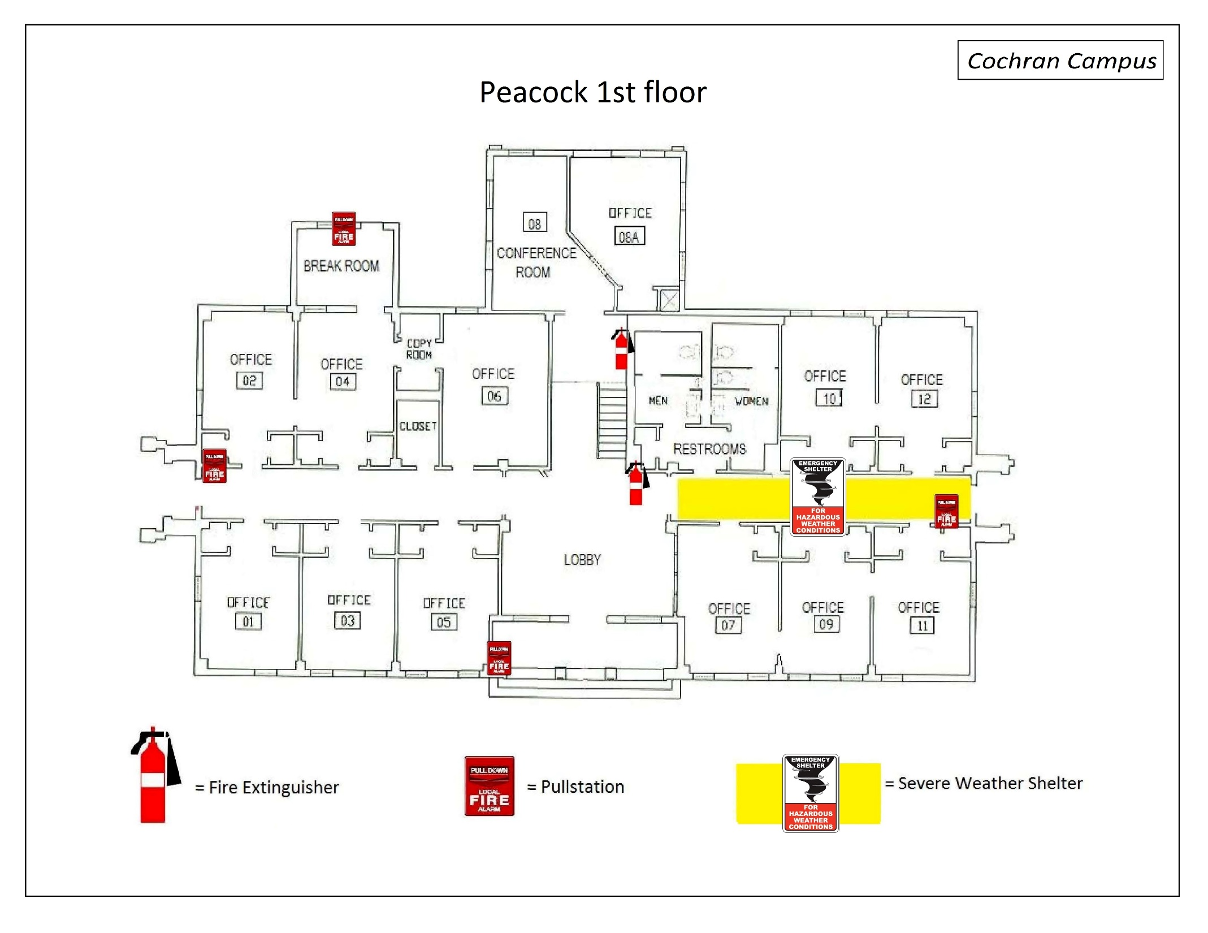
2nd floor will also assemble on 1st floor

Slide 33
2nd and 3rd floors will also assemble on 1st floor

Slide 34
2nd and 3rd floors will also assemble on 1st floor

Slide 35
2nd and 3rd floors will also assemble in 1st floor auditorium

Slide 36
2nd floor will also assemble on 1st floor

Slide 37
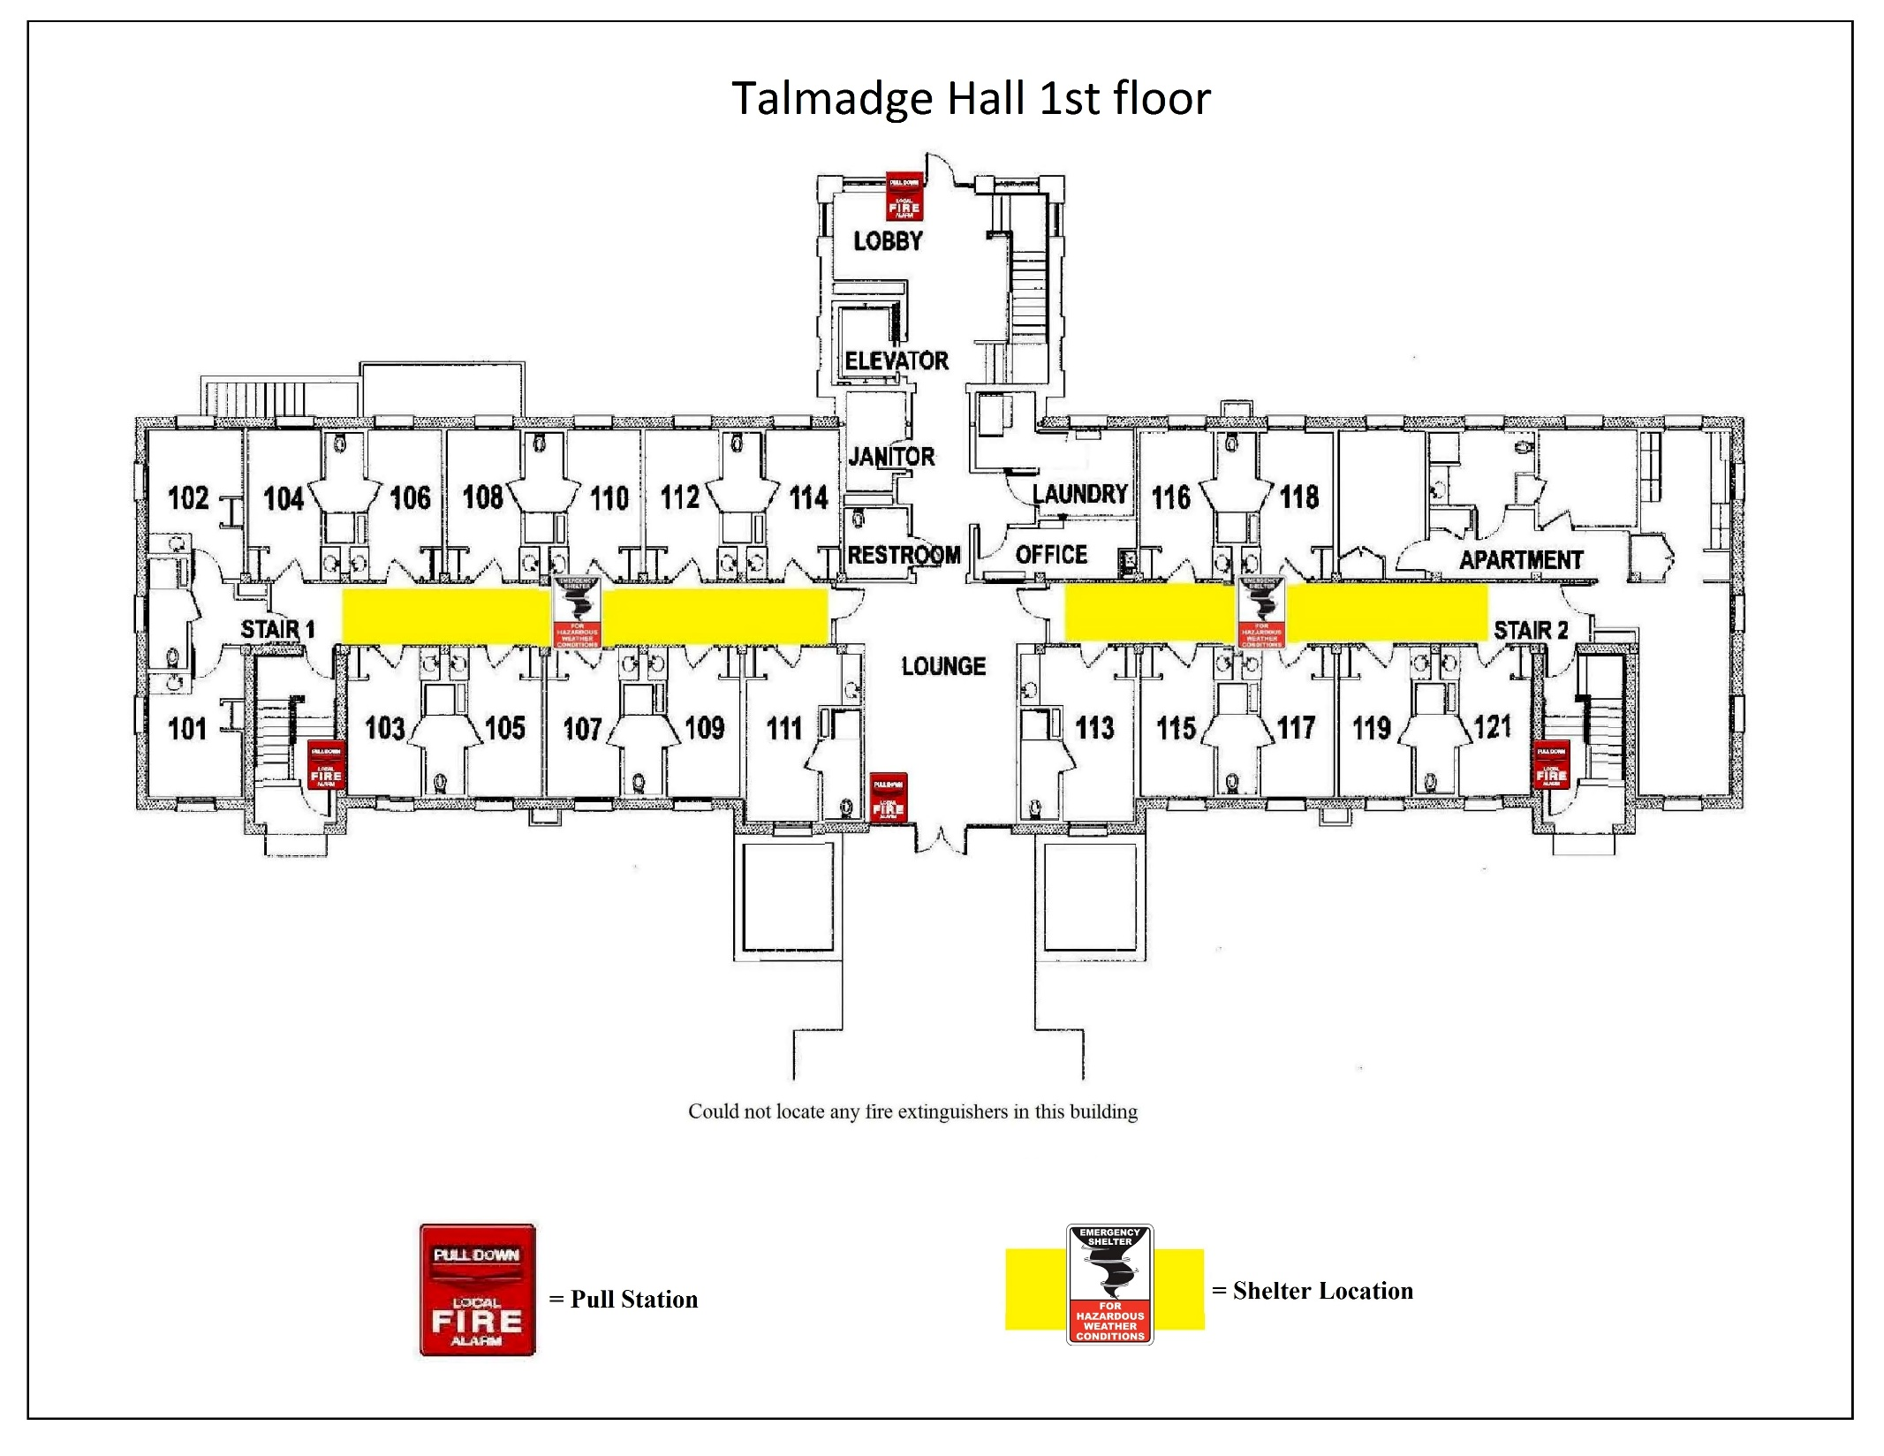
2nd floor will also assemble on 1st floor

Slide 38
1st and 2nd floors will also assemble on basement floor

Slide 39
Knights Hall 1st Floor Safety Diagram
2nd and 3rd floors will also assemble on 1st floor

Slide 41
2nd and 3rd floors will also assemble on 1st floor

Slide 43
2nd floor will also assemble on 1st floor

Slide 44
Outdoor assembly
The following are locations for each building in the event of an evacuation.
When exiting:
Assist disabled persons in exiting the building
Do not use elevators
Once outside, proceed to predesignated area for your building
Leave streets and walkways clear for emergency vehicles and personnel
Do not return to building unless told to by MGA officials
Entire campus evacuation will be announced by Chief of Police

Slide 45
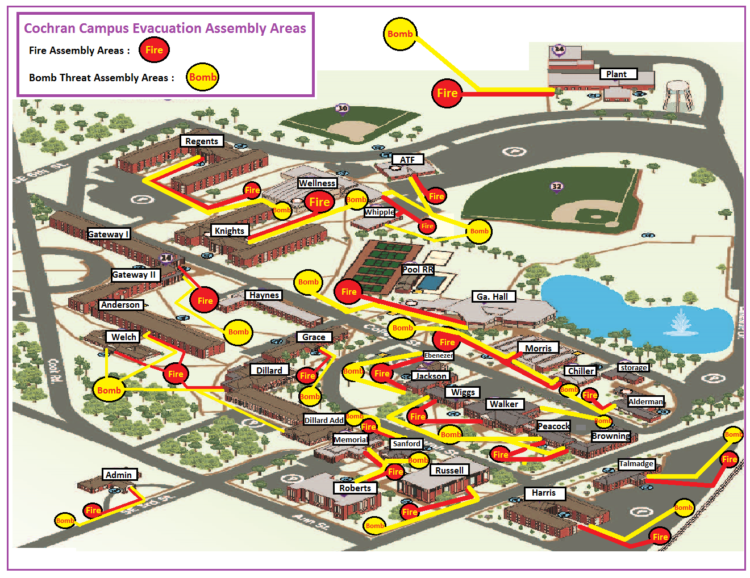

Slide 46
First aid
Remain calm and assess the situation
Do not put yourself in danger
Medical Emergency:
Contact University Police (478) 934-3002 or 911
Contact Health Services (478) 271-5401
Do not move injured person unless they are in immediate danger of further injury
Check breathing & initiate first aid – do not touch individual without personal protection if there is danger of coming into contact with bodily fluids
Only perform CPR if certified or if Police instruct you to
Minor Injury:
Utilize items in the nearest first aid kit
Instruct individual to consult with their doctor or Health Services

Slide 47
Automated external defibrillator (AED)
The AED will give you step-by-step voice prompts to follow
Immediately summon bystander to notify University Police
Claire's Story

Slide 48
contact info
University Police (478) 934-3002
Bleckley County Hospital (478) 934-6211
Health Services (478) 271-5401
Plant Operations (478) 934-3000
Risk Management (478) 471-2506

Slide 49
Helpful Links
Cochran Oil Spill Plan
MGA Emergency Response Plan
Shelter Locations
Report a Hazard (non-emergencies)
Right To Know (RTK) Plan
Risk Management
University Police
Plant Operations
Technology Resources

