Slide 1
Cybersecurity Primer
Information Security Awareness

Slide 2
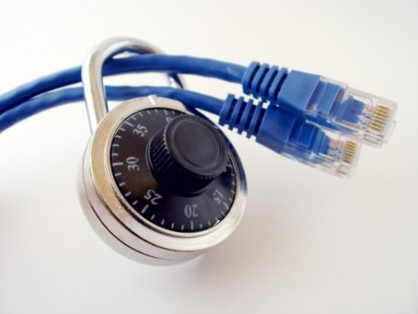
Importance of Cybersecurity
The internet allows an attacker to work from anywhere on the planet.
Risks caused by poor security knowledge and practice:
  Identity Theft
  Monetary Theft
  Legal Ramifications (for yourself and your organization)
  Sanctions or termination if policies are not followed
According to the SANS Institute, the top vectors for vulnerabilities available to a cyber criminal are:
  Web Browser
  IM Clients
  Web Applications
  Excessive User Rights

Slide 3
Cybersecurity is Safety
Security: We must protect our computers and data in the same way that we secure the doors to our homes.
Safety: We must behave in ways that protect us against risks and threats that come with technology.
Notes:
Security: The way in which we protect access to our computers and information. E.g. Anti-virus software, firewall
Safety: The we behave while using the internet. E.g. Safe email behavior, safe software downloading behavior
Stress the difference and the importance of both together to provide a safe and secure computing environment.

Slide 4

User Awareness
Cyber-Criminals
System Administrators
Some scripts appear useful
to manage networks…
Cracker:
Computer-savvy
programmer creates
attack software
Posts to
Hacker Bulletin Board
SQL Injection
Buffer overflow
Password Crackers
Password Dictionaries
Successful attacks!
Crazyman broke into …
CoolCat penetrated…
Script Kiddies:
Unsophisticated computer users who know how to
execute programs
Downloads
Reports
Posts to
Criminals: Create & sell bots -> generate spam
Sell credit card numbers, etc…
Malware package earns $1K-2K
1 M Email addresses earn $8
10,000 PCs earn $1000
Notes:
Users must be aware of the threats that exist in order to properly detect and prevent them.

Slide 5


Leading Threats
Viruses
Worms
Trojan Horses / Logic Bombs
Social Engineering
Rootkits
Botnets / Zombies

Slide 6
Viruses
A virus attaches itself to a program, file, or disk.
When the program is executed, the virus activates and replicates itself.
The virus may be benign or malignant but executes its payload at some point (often upon contact).
  Viruses can cause computer crashes and loss of data.
In order to recover or prevent virus attacks:
  Avoid potentially unreliable websites/emails.
  System Restore.
  Re-install operating system.
  Use and maintain anti-virus software.
Program
A
Extra Code
infects
Program
B
Notes:
Viruses
Computer viruses are software programs that are deliberately designed by online attackers to invade your computer, to interfere with its operation, and to copy, corrupt or delete your data. These malicious software programs are called viruses because they are designed not only to infect and damage one computer, but to spread to other computers all across the Internet.
Computer viruses are often hidden in what appear to be useful or entertaining programs or e-mail attachments, such as computer games, video clips or photos. Many such viruses are spread inadvertently by computer users, who unwittingly pass them along in e-mail to friends and colleagues.

Slide 7
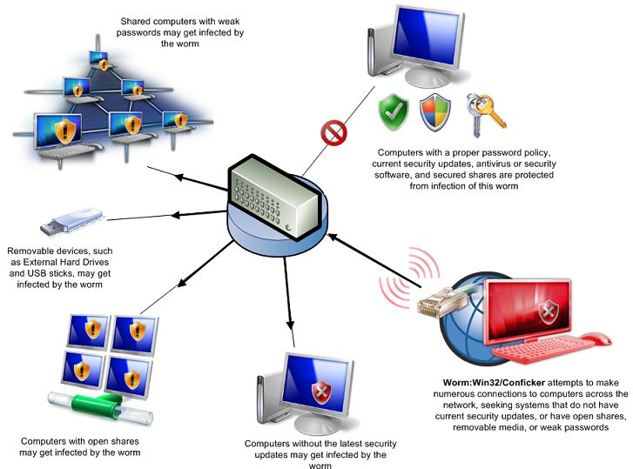
Worms
Independent program that replicates itself and sends copies from computer to computer across network connections.
Upon arrival, the worm may be activated to replicate.
To Joe
To Ann
To Bob
Email List:
Joe@gmail.com
Ann@yahoo.com
Bob@u.edu
Notes:
Worms
Worms are more sophisticated viruses that can replicate automatically and send themselves to other computers by first taking control of certain software programs on your PC, such as email.

Slide 8
Logic Bombs and Trojan Horses
Logic Bomb: Malware logic executes upon certain conditions. The program is often used for otherwise legitimate reasons.
  Examples:
  Software which malfunctions if maintenance fee is not paid.
  Employee triggers a database erase when he is fired.
Trojan Horse: Masquerades as a benign program while quietly destroying data or damaging your system.
  Download a game: It may be fun but contains hidden code that gathers personal information without your knowledge.
Notes:
Logic Bomb
Malware that destroys data when certain conditions are met. E.g., it may format a hard drive or change data files (possibly by inserting random bits of data) on a particular date or time or if a certain employee record is missing from the employee database.
Example: an employee places a logic bomb inside a system to destroy data when his/her record is removed upon termination.
Trojan Horses
A Trojan horse is a program which seems to be doing one thing, but is actually doing another. A Trojan horse can be used to set up back door in a computer system so that the intruder can gain access later.
The name refers to the horse from the Trojan War, with similar function of deceiving defenders into bringing an intruder inside.

Slide 9


Social Engineering
Social engineering manipulates people into performing actions or divulging confidential information. Similar to a confidence trick or simple fraud, the term applies to the use of deception to gain information, commit fraud, or access computer systems.
Email:
ABC Bank has
noticed a
problem with
your account…
Phone Call:
This is John, the System Administrator. What is your password?
In Person:
What ethnicity are you? Your mother’s maiden name?
I have come to repair your machine…
and have some lovely software patches!
Notes:
Social Engineering can occur in-person, over the phone, in emails or fake web pages.
Social Engineering: non-technical or low-technology means - such as lies, impersonation, tricks, bribes, blackmail, and threats - used to attack information systems.
The next two slides discuss two types of Social Engineering: phishing and pharming.

Slide 10
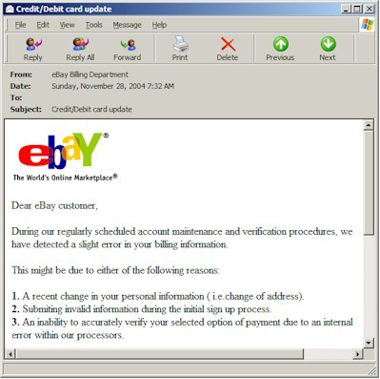
Phishing: Counterfeit Email
Phishing: A seemingly trustworthy entity asks for sensitive information such as SSN, credit card numbers, login IDs or passwords via e-mail.
Notes:
Phishing: A type of Social Engineering. The use of e-mails that appear to originate from a trusted source to trick a user into entering valid credentials at a counterfeit website. Typically the e-mail and the web site looks like they are part of a trusted organization with whom the user is familiar.

Slide 11
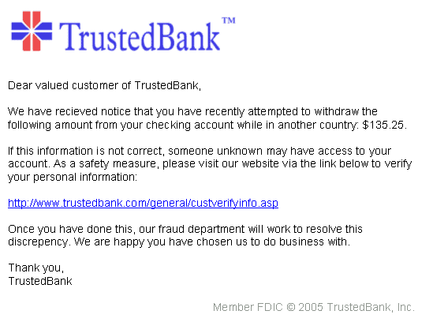
Pharming: Counterfeit Web Pages
Wiping over, but not clicking the link may reveal a different address.
Misspelled
With whom?
Copyright date is old
The link provided in the e-mail leads to a counterfeit webpage which collects important information and submits it to the owner.
The counterfeit web page looks like the real thing
  Extracts account information
Notes:
Pharming: Another type of social engineering. A user’s session is redirected to a masquerading website. At the fake website, transactions can be mimicked and information like login credentials can be gathered. With this the attacker can access the real site and conduct transactions using the credentials of a valid user on that website.

Slide 12
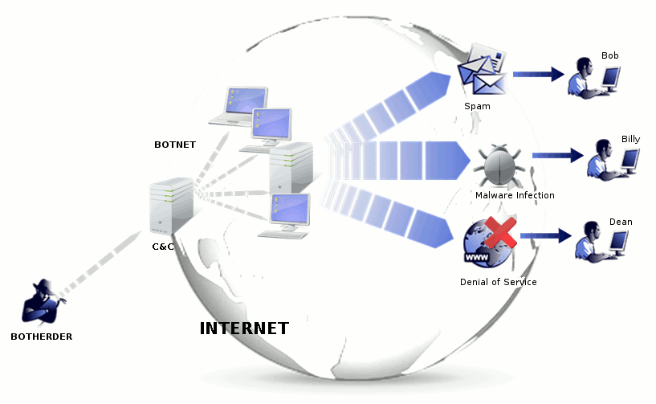
Botnet
A botnet is a number of compromised computers used to create and send spam or viruses or flood a network with messages as a denial of service attack.
The compromised computers are called zombies.
Notes:
When your computer becomes infected, it is likely to become a bot. Because attacks are international, they are hard to locate and eradicate.
Zombie: a compromised computer which may host pornography, illegal music and/or movies
Botnet: a “zombie army,” or collection of compromised computers, zombies, used to send out spam, viruses or distributed denial of service attacks.

Slide 13
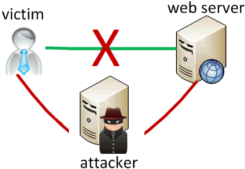
Man In The Middle Attack
An attacker pretends to be your final destination on the network. When a person tries to connect to a specific destination, an attacker can mislead him to a different service and pretend to be that network access point or server.
Notes:
Man in the middle attackers can deploy decoy wireless access points near legitimate ones but pretend to be legitimate. The decoy access point resembles the legitimate one, fooling unwitting users into giving up their credentials.

Slide 14
Rootkit
Upon penetrating a computer, a hacker may install a collection of programs, called a rootkit.
May enable:
  Easy access for the hacker (and others)into the enterprise
  Keystroke logger
Eliminates evidence of break-in.
Modifies the operating system.
Backdoor entry
Keystroke Logger
Hidden user
Notes:
RootKit: A collection of programs that a hacker uses to mask intrusion and obtain administrator-level access to a computer or computer network.

Slide 15
Password Cracking
Dictionary Attack and Brute Force
Pattern | Calculation | Result | Time to Guess (2.6x10¹⁸ tries/month)
Personal Info: interests, relatives |  | 20 | Manual 5 minutes
Social Engineering |  | 1 | Manual 2 minutes
American Dictionary |  | 80,000 | < 1 second
4 chars: lower case alpha | 26⁴ | 5x10⁵
8 chars: lower case alpha | 26⁸ | 2x10¹¹
8 chars: alpha | 52⁸ | 5x10¹³
8 chars: alphanumeric | 62⁸ | 2x10¹⁴ | 3.4 min.
8 chars alphanumeric +10 | 72⁸ | 7x10¹⁴ | 12 min.
8 chars: all keyboard | 95⁸ | 7x10¹⁵ | 2 hours
12 chars: alphanumeric | 62¹² | 3x10²¹ | 96 years
12 chars: alphanumeric + 10 | 72¹² | 2x10²² | 500 years
12 chars: all keyboard | 95¹² | 5x10²³
16 chars: alphanumeric | 62¹⁶ | 5x10²⁸
Notes:
This chart shows the different combinations of passwords and password lengths and how long a dictionary attack or brute force attack would take to guess the password.
Discussion of proper password creation and change techniques will occur later in the User Practices section of the presentation.
At this stage just discuss the attacks and comparisons to password lengths and patterns.
Brute Force Attack: A cryptanalysis technique or other kind of attack method involving an exhaustive procedure that tries all possibilities, one-by-one.
Dictionary Attack: An attack that tries all of the phrases or words in a dictionary, trying to crack a password or key. A dictionary attack uses a predefined list of words compared to a brute force attack that tries all possible combinations.

Slide 16

Georgia Data Breach Notification Law
O.C.G.A. §§10-1-910, -911, -912
An unauthorized acquisition of electronic data that compromises the security, confidentiality or integrity of “personal information.”
Personal Information
  Social Security Number.
  Driver’s license or state ID number.
  Information permitting access to personal accounts.
  Account passwords or PIN numbers or access codes.
  Any of the above in connection with a person’s name if the information is sufficient to perform identity theft against the individual.
Notes:
. NIST also recommends including criminal records, student grades, passport numbers, mortgage numbers, civil court numbers, date/place of birth, and more.

Slide 17

Identifying Security Compromises
Symptoms:
  Antivirus software detects a problem.
  Disk space disappears unexpectedly.
  Pop-ups suddenly appear, sometimes selling security software.
  Files or transactions appear that should not be there.
  The computer slows down to a crawl.
  Unusual messages, sounds, or displays on your monitor.
  Stolen laptop: 1 stolen every 53 seconds; 97% never recovered.
  The mouse pointer moves by itself.
  The computer spontaneously shuts down or reboots.
  Often unrecognized or ignored problems.

Slide 18
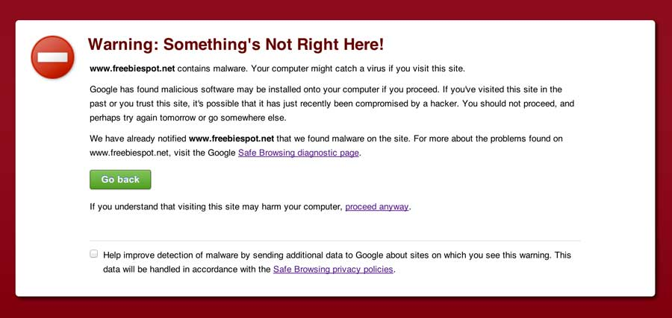
Malware detection
Spyware symptoms:
  Changes to your browser homepage/start page.
  Ending up on a strange site when conducting a search.
  System-based firewall is turned off automatically.
  Lots of network activity while not particularly active.
  Excessive pop-up windows.
  New icons, programs, favorites which you did not add.
  Frequent firewall alerts about unknown programs when trying to access the Internet.
  Poor system performance.

Slide 19
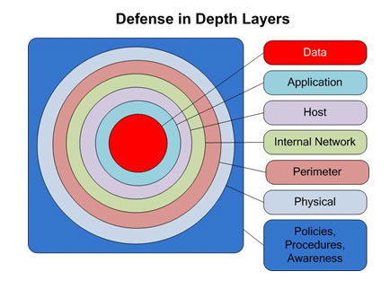
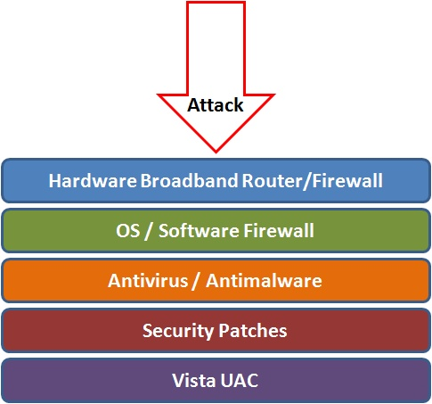
Best Practices to avoid these threats
Defense in depth uses multiple layers of defense to address technical, personnel and operational issues.
User Account Controls

Slide 20
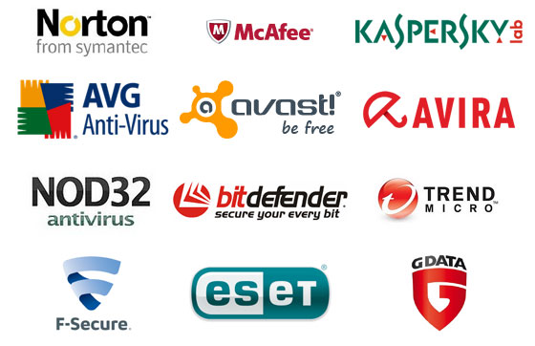
Anti-virus and Anti-spyware Software
Anti-virus software detects certain types of malware and can destroy it before any damage is done.
Install and maintain anti-virus and anti-spyware software.
Be sure to keep anti-virus software updated.
Many free and commercial options exist.
Contact your Technology Support Professional for assistance.

Slide 21
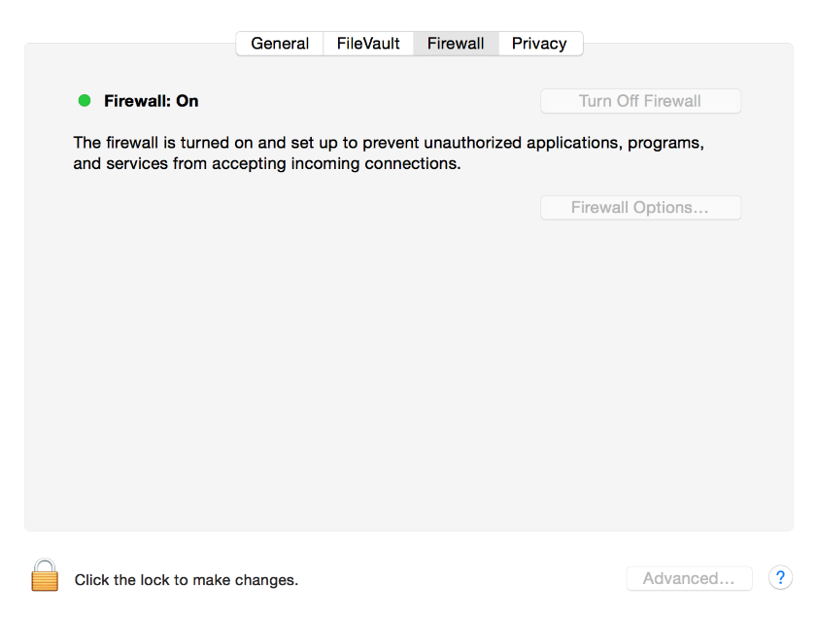
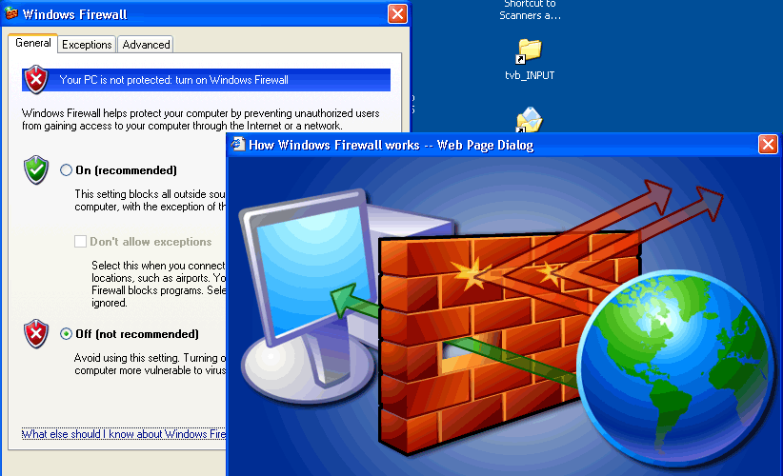
Host-based Firewalls
A firewall acts as a barrier between your computer/private network and the internet. Hackers may use the internet to find, use, and install applications on your computer. A firewall prevents many hacker connections to your computer.
Firewalls filter network packets that enter or leave your computer
Notes:
Windows and Mac OS X have host-based firewall software built-in. Be sure to always have it on.
It is necessary to have software firewalls on each computer even if you have a hardware firewall protecting your network. If your hardware firewall is compromised by a hacker or by malicious code of some kind, you don’t want the intruder or malicious program to have unlimited access to your computers and the information on those computers.
Every computer in the network should have its own software firewall enabled.
Windows and Mac OS X operating systems have a built-in firewall, which can be easily located in the control panel on the PC or System Preferences on the Mac. Ensure it is always turned on.
For other commercial operating systems, the operations manual should have instructions about the firewall options.
For an optional implementation of firewall security, commercial third-party firewall software can be installed.

Slide 22
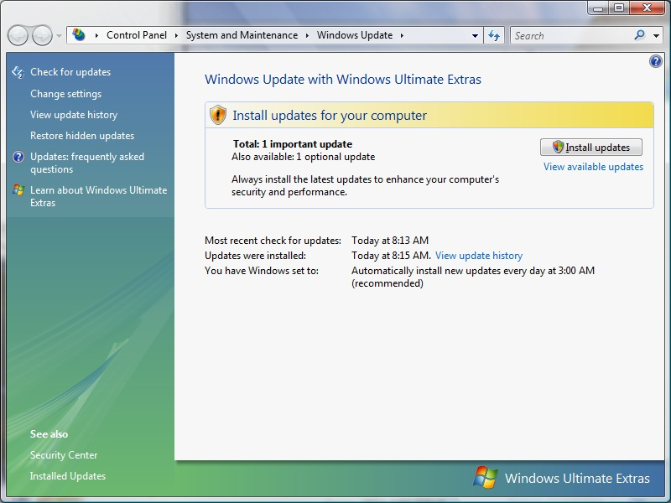

Protect your Operating System
Microsoft regularly issues patches or updates to solve security problems in their software. If these are not applied, it leaves your computer vulnerable to hackers.
The Windows Update feature built into Windows can be set up to automatically download and install updates.
Avoid logging in as administrator
Apple provides regular updates to its operating system and software applications.
Apply Apple updates using the App Store application.

Slide 23
Use Strong Passwords
Make passwords easy to remember but hard to guess
USG standards:
Be at least ten characters in length
Must contain characters from at least two of the following four types of characters:
  English upper case (A-Z)
  English lower case (a-z)
  Numbers (0-9)
  Non-alphanumeric special characters ($, !, %, ^, …)
Must not contain the user’s name or part of the user’s name
Must not contain easily accessible or guessable personal information about the user or user’s family, such as birthdays, children’s names, addresses, etc.
Notes:
Make passwords according to organization standards. USG has set a minimum.

Slide 24
Creating Strong Passwords
A familiar quote can be a good start:
Using the organization standard as a guide, choose the first character of each word:
    LIASMWTFOS
Now add complexity the standard requires:
    L1A$mwTF0S (10 characters, 2 numerals, 1 symbol, mixed English case: password satisfies all 4 types).
Or be more creative!
“LOVE IS A SMOKE MADE WITH THE FUME OF SIGHS”
William Shakespeare

Slide 25

Password Guidelines
Never use admin, root, administrator, or a default account or password for administrative access.
A good password is:
  Private: Used by only one person.
  Secret: It is not stored in clear text anywhere,
  including on Post-It® notes!
  Easily Remembered: No need to write it down.
  Contains the complexity required by your organization.
  Not easy to guess by a person or a program in a reasonable time, such as several weeks.
  Changed regularly: Follow organization standards.
Avoid shoulder surfers and enter your credentials carefully! If a password is entered in the username field, those attempts usually appear in system logs.

Slide 26

Avoid Social Engineering and Malicious Software
Do not open email attachments unless you are expecting the email with the attachment and you trust the sender.
Do not click on links in emails unless you are absolutely sure of their validity.
Only visit and/or download software from web pages you trust.
Notes:
Email Attachments
Attachments should be opened only from trusted senders.
If you are not expecting an email attachment from the sender, it’s a good idea to call and confirm, before opening the attachment.
Spam email often asks for sensitive information.
Links in emails
Never click on link in email attachment, except only when you are expecting it.
If you are not expecting an email link from the sender, it’s a good idea to call and confirm, before clicking the email link.
If you hover the cursor over an email’s web link description, the link should be displayed on the bottom of the browser. Make sure both of them match.
Trustworthy Web Pages
Software download should be done only from trusted websites like Microsoft for Windows updates and Office application updates.
Avoid downloading and using freeware or shareware, since most of them either don’t come with technical support or full functionality.

Slide 27

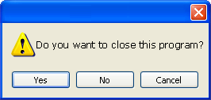
Avoid Stupid Hacker Tricks
Be sure to have a good firewall or pop-up blocker installed.
Pop-up blockers do not always block ALL pop-ups so always close a pop-up window using the ‘X’ in the upper corner.
Never click “yes,” “accept” or even “cancel.”
Infected USB drives are often left unattended by hackers in public places.
Notes:
A pop-up blocker should be installed (many browsers have them as add-ons), but they do not always block all pop-ups
Do not respond to pop ups while working online. For example, a malicious pop up message may say that you have a virus on the system. Close it by clicking on X in the upper right corner. If you click OK, it might install spyware or other malicious code.‘
Infected USB drives are often left unattended by hackers in public places. They intend for unsuspecting people to take the USB home or to the office and unknowingly install the worm or malicious code.

Slide 28
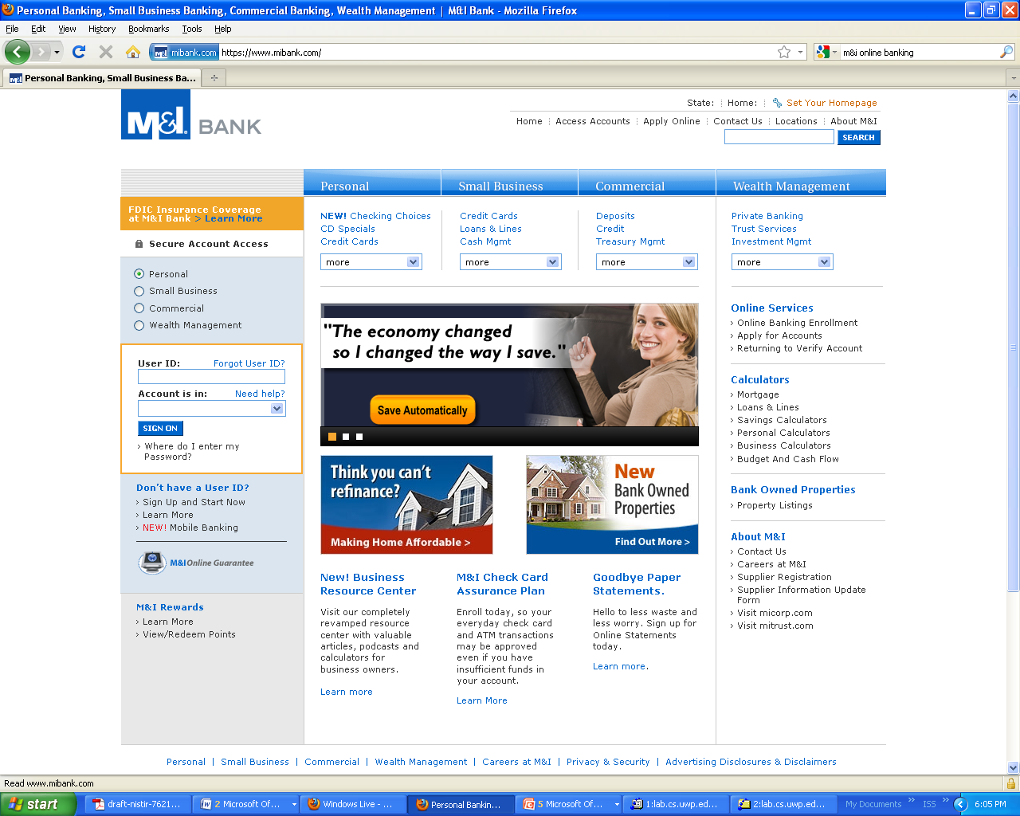
Secure Business Transactions
Always use secure browser to do online activities.
Frequently delete temp files, cookies, history, saved passwords etc.
https://
Symbol indicating
enhanced security
Notes:
Always use secure browser to do online activities.
Frequently delete temp files, cookies, history, saved passwords etc.
Look for https and/or lock or secure symbol

Slide 29

Backup Important Information
No security measure is 100% reliable.
Even the best hardware fails.
What information is important to you?
Is your backup:
    Recent?
    Off-site & Secure?
    Process Documented?
    Encrypted?
    Tested?
Notes:
Backup should be done (at least)once a week. If possible, store to a removable media.
The removable media should be big enough to hold 52 weeks of backup (e.g., 500GB).
Do a full backup once a month and store it in offsite location. This would be useful in case of a disaster in your office (fire, theft, flood, etc). On the removable media create 12 folders for each month.
Backup data should be tested periodically to ensure reliability.

Slide 30
Cyber Incident Reporting
If you suspect a cybersecurity incident, notify your organization’s help desk or the USG ITS help desk immediately. Be prepared to supply the details you know and contact information.
Do not attempt to investigate or remediate the incident on your own.
Inform other users of the system and instruct them to stop work immediately.
Unless instructed, do not power down the machine.
Unless instructed, do not remove the system from the network.
The cybersecurity incident response team will contact you as soon as possible to gather additional information.
Each USG organization is required to have a specific plan to handle cybersecurity incidents. Refer to local policies, standards and guidelines for specific information.
Notes:
Cyber incident reporting standards are detailed in section 5.3 of the IT handbook. These are general standards and are operationalized by guidelines specific to the USG organization.

Slide 31
Fraud
Organizations lose 5-6% of revenue annually due to internal fraud = $652 Billion in U.S. (2006)
Average scheme lasts 18 months, costs $159,000
25% costs exceed $1M
Smaller companies suffer greater average dollar losses than large companies

Slide 32
Fraud Discovery
Tips are the most common way fraud is discovered.
Tips come from:
  Employee/Coworkers 64%,
  Anonymous 18%,
  Customer 11%,
  Vendor 7%
If you suspect possible fraud, report it anonymously to the USG ethics hot line at 877-516-3466.
Notes:
Tips on fraud are most frequent method of discovering it.
The percentages given for where the tips come from are percentages of total tips, not total fraud discoveries.

Slide 33


University System of Georgia
Information Technology Services

